Slide 1
Condensed Matter Physics I
Prof. Dr. Ir. Paul H.M. van Loosdrecht
II Physikalisches Institut, Room 312
E-mail: pvl@ph2.uni-koeln.de
Website: http:/www.loosdrecht.net/

Slide 2
Lectures and Working Class
Lectures & problem session on
Tuesday 10:00 : 11:30
Thursday 12:00 : 13:30
Problem sessions on Thursday alternating with lectures
Problem session teacher:
Dr. Matteo Montagnese, II P.I. room 318
m.montagnese@ph2.uni-koeln.de
Hand in problem sets on Tuesday’s (room 318).

Slide 3
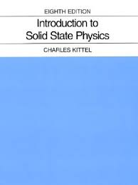
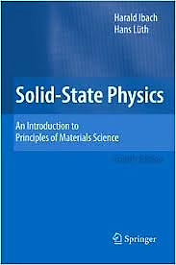
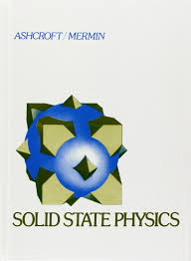
Literature
Introduction to Solid State Physics, Charles Kittel
Solid State Physics, Ibach & Lüth
Solid State Physics, Ashcroft & Mermin
Quantum theory of solids, Kittel
Principles of condensed matter physics, Chaikin & Lubensky
Many, many more

Slide 4
States of matter
Liquid crystals
glasses
Amorphous solids
quasi crystals
nearly periodic crystals
PERIODIC CRYSTALS
Plasma
Gas
Liquid
SOLIDS

Slide 5
Structure and symmetry
Binding
Diffraction -> reciprocal space
Vibrations & thermal properties, density of states
Electrons, Fermi Gas, Energy bands, semiconductors
Collective excitations (plasmons, excitons, etc.)
Dielectrical properties
Spins: magnetism & magnetic excitations

Slide 6
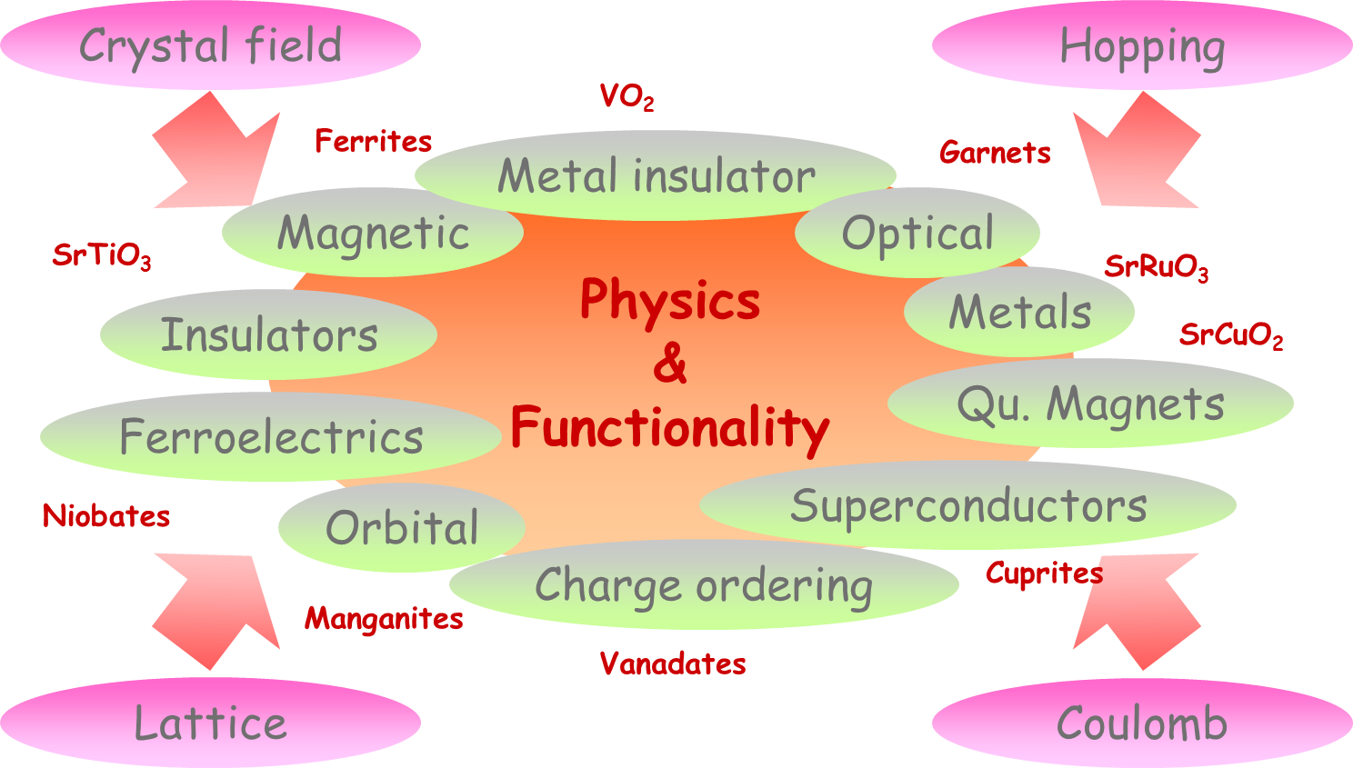
II. Physikalisches Institut

Slide 7
STRUCTURE
Kittel Ch.1

Slide 8
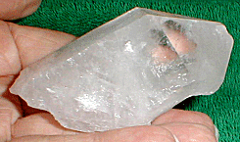
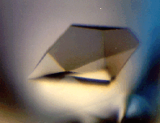
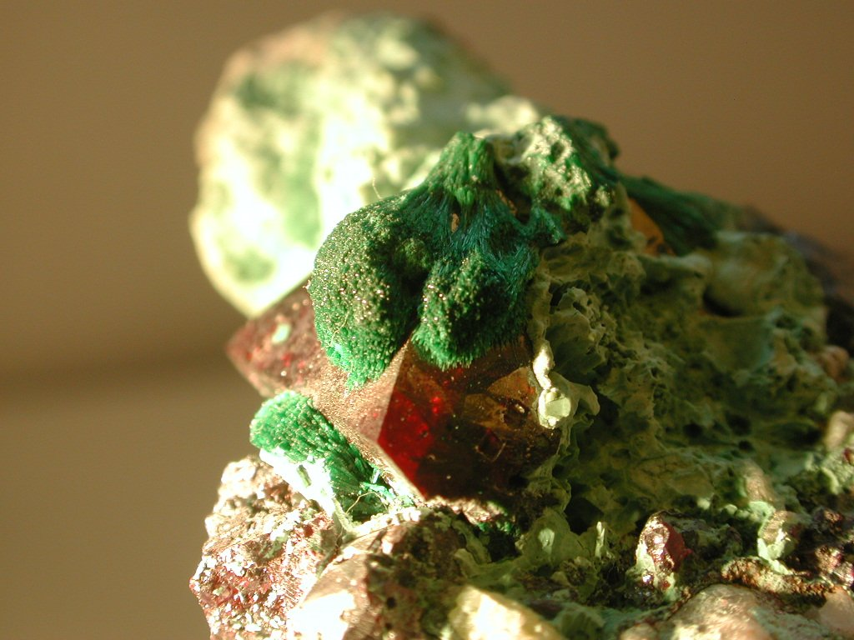
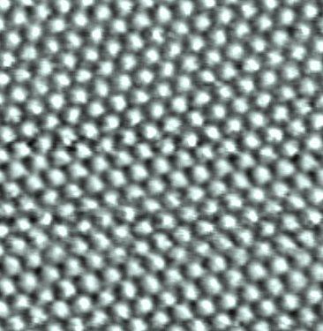
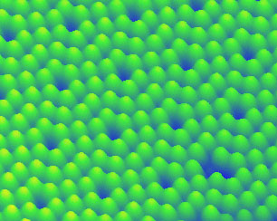
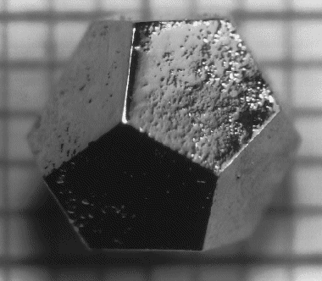
Quartz
Protein
Cu₂O
Graphite
Silicon
Quasi-crystal

Slide 9
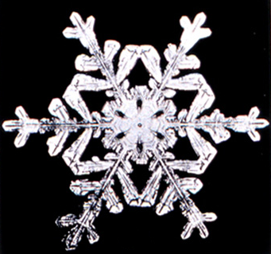
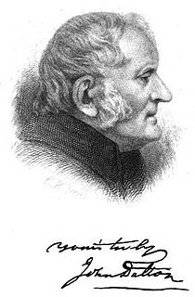
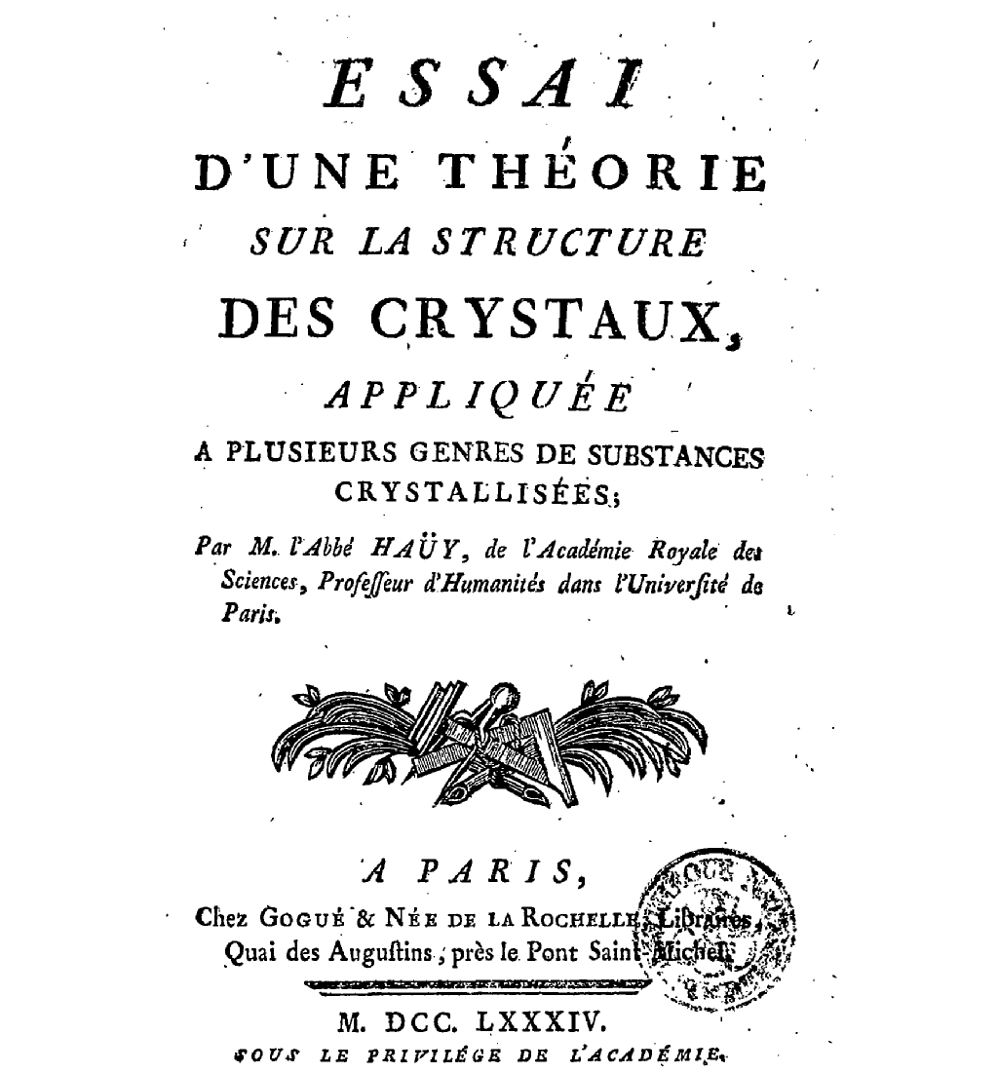
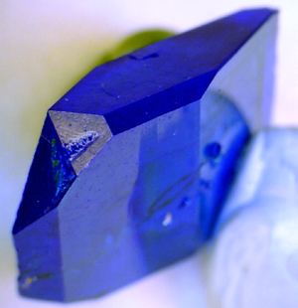
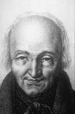
Structure
460 BC Demokritus: idea that matter is made of ‘atoms’
1611 J. Keppler: Snow Xtals made of spherical water molecules
1784 R.J. Haüy: Law of integral indices
1802 J. Dalton: atomic theory

Slide 10
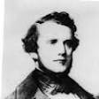
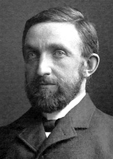
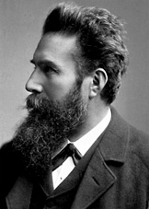
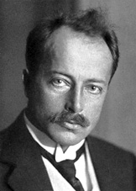
Structure
1784 R.J. Haüy: Law of integral indices
1850 A. Bravais: Space lattices
1895 W. Röntgen: X-rays (1st Nobel prize 1901,
Work on cathode rays: Lenard 1905)
1912 M. van Laue: Diffraction (Nobel prize 1914)

Slide 11
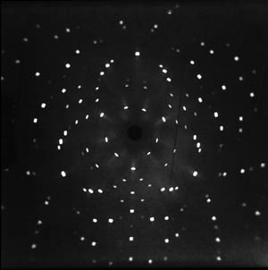
Si (FCC) 111 axis
Using hard X-rays (λ ~ a ~ 10 Å)

Slide 12
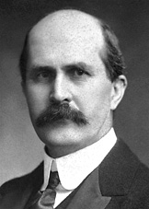
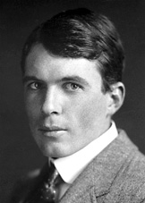
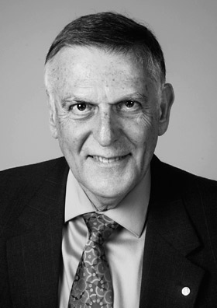
Structure
1913/14 W.&L. Bragg: Diffraction (Nobel prize 1915)
1984 D. Shechtman: Quasicrystals (Chem. Nobel prize 2011)

Slide 13
Symmetry
Translation symmetry:
vectors representing translations which
transform a structure into itself
Rotation symmetry:
Operations (rotations, mirrors) which
transform a structure into itself

Slide 14
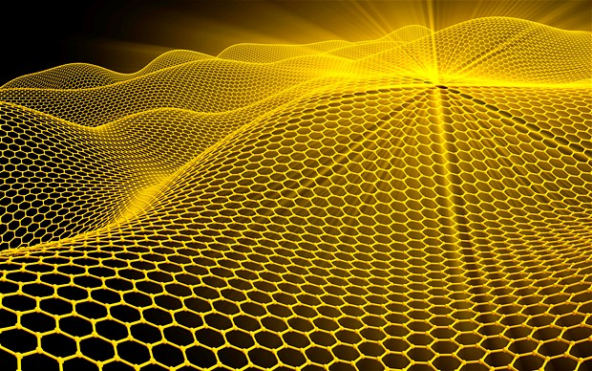
2л/6 rotation
Translations

Slide 15
Lattice
Periodic Arrays of points
or
Lattice = set of fundamental translation vectors:
T = u₁a₁ + u₂a₂ + u₃a₃
a₂
a₂
a₁
a₁

Slide 16
Crystal structure
Lattice + Basis = Crystal structure
Basis = group of atoms forming the unit cell:
Basis
Lattice
Crystal Structure

Slide 17
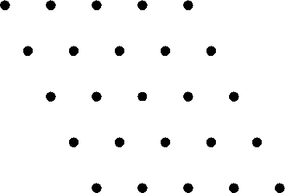
Primitive cell
Minimal volume unit cell
“Conventional” unit cell
A unit cell is not necessarily primitive!
Primitive cell

Slide 18
Primitive cell
Minimal volume unit cell
Primitive Translation vectors: a₁ , a₂ , a₃
Primitive Lattice Cell = parallelepiped of a₁ , a₂ , a₃
Many equivalent options to choose from,
Volume of Primitive Lattice cell: V = a₁ . (a₂ x a₃ )
Wigner-Seitz Cell: Most symmetric choice of Primitive Cell

Slide 19
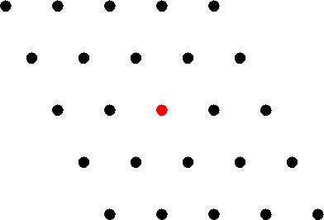

Wigner-Seitz cell

Slide 20
Symmetry elements
Translations: T = u₁a₁ + u₂a₂ + u₃a₃
Point group operations: Rotations and Mirrors
Combinations: Glide planes and Screw axes
Glide plane
6 fold rotation

Slide 21
Two dimensional lattices
(Net)
Ratio |a₁/a₂|
Angle β
a₂
β
a₁

Slide 22
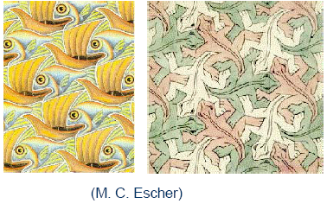
Two dimensional lattices
(Net)

Slide 23
2D lattice types
1-fold: Oblique
a₁ ≠ a₂; β
1-fold + mirror:
Centered rectangular
a₁ ≠ a₂; α = 90º
2-fold: Rectangular
a₁ ≠ a₂; β = 90º
4-fold: Square
a₁ = a₂; β = 90º
6-fold: Hexagonal
a₁ = a₂; β = 120º

Slide 24
3D lattice types
The 3D lattice types (14)
Triclinic | 1 | No symmetries
Monoclinic | 2 | Two right angles
Orthorhombic | 4 | Three right angles
Tetragonal | 2 | Three right angles + 4 fold
Cubic (SC, FCC, BCC) | 3 | Three right angles + 4 fold + 3 fold
Trigonal | 1 | Three equal angles (not 90^{o)}+ 3 fold
Hexagonal | 1 | Two right, one 120º + 6 fold

Slide 25
Cubic lattices
Simple cubic
SC
Body centered
BCC
Face centered
FCC
Po
Na, K, Rb, Cs,
Fe, V, Cr, Mo, W
Ni, Cu, Ag, Au, Pt,
Ne, Ar, Kr, Xe, Rn

Slide 26
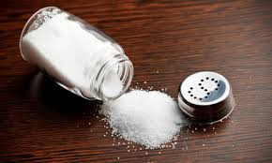
NaCl Structure
Rocksalt structure
NaCl
SnTe
NaF
MgO

Slide 27
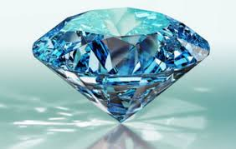
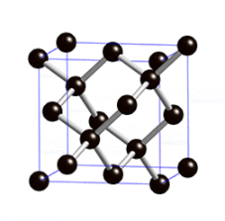
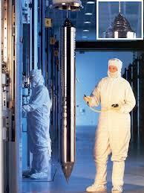
Diamond structure
C,Si,Ge

Slide 28
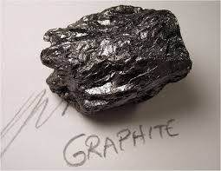
Hexagonal closed packed
H, He, N
Be, Mg
Co, Zn, Sc, Ti
Y, Zr, Tc, Ru, Cd
Hf, Re, Os, Tl,
Pr, Gd, Tb, Dy, Ho, Er, Lu

Slide 29
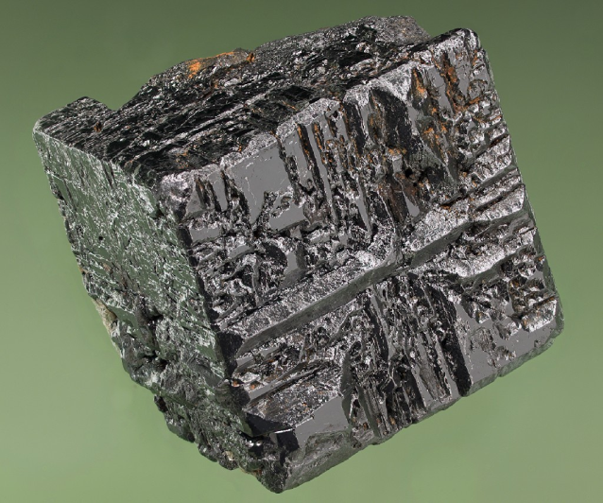
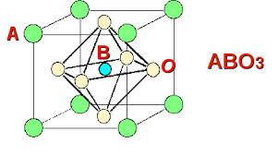
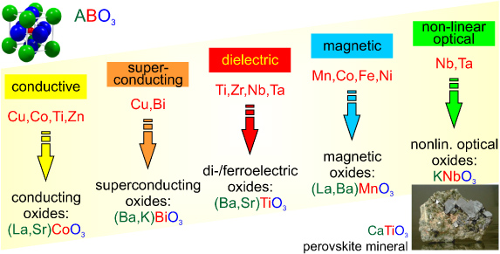
Perovskite structure
CaTiO₃
Matthias Opel 2012 J. Phys. D: Appl. Phys. 45 033001

Slide 30
Planes and directions
Miller indices:
Find intercepts with axes
of unit cell (in cell units).
Take reciprocals
Find (smallest) integers
with the same ratio
z
O
y
() Planes
{} Equivalent planes
Cubic
{100}: (100),(200),(001)
[] directions:
x-direction [100]
x

Slide 31
Planes and directions
Miller indices:
Find intercepts with axes
of unit cell (in cell units).
Take reciprocals
Find (smallest) integers
with the same ratio
z
Intersections at (1,∞,∞)
Miller indices (100)
O
y
x

Slide 32
Planes and directions
Miller indices:
Find intercepts with axes
of unit cell (in cell units).
Take reciprocals
Find (smallest) integers
with the same ratio
z
Intersections at (1,1,∞)
Miller indices (110)
O
y
x

Slide 33
Planes and directions
Miller indices:
Find intercepts with axes
of unit cell (in cell units).
Take reciprocals
Find (smallest) integers
with the same ratio
z
Intersections at (1,1,1)
Miller indices (111)
O
y
x

