Slide 1
Condensed Matter Physics I
Prof. Dr. Ir. Paul H.M. van Loosdrecht
II Physikalisches Institut, Room 312
E-mail: pvl@ph2.uni-koeln.de
Website: http:/www.loosdrecht.net/

Slide 2
Previously
Binding Attractive and repulsive potentials
Lattice sums, cohesive energy, equilibrium structure
Reciprocal space
Diffraction

Slide 3
Today
Phonons (Ch.4 & 5 Kittel)

Slide 4
PHONONS

Slide 5
Elementary excitations in solids
Charge | Electronic excitations
EM field | Photon
Elastic | Phonon
Magnetic | Magnon (spin-wave)
Multi-particle | Exciton, polariton, polaron
Collective | Plasmon
… | …

Slide 6
Phonons
Propagation of sound
Optical properties (infrared)
Lattice expansion
Heat capacity
Thermal conductivity

Slide 7
General
Total lattice energy
Stability: Equilibrium coordinates
Harmonic approximation:

Slide 8
1D, 1 at./cell
C
M
ω
−π/a
0
π/a
k

Slide 9
Relevant values of k
ω
−π/a
0
π/a
2π/a
3π/a
k

Slide 10
Relevant values of k
ω
−π/a
FIRST BRILLOUIN ZONE
0
π/a
2π/a
3π/a
k

Slide 11
1 dimensional -- 2 at./cell
u_{s}
v_{s}
u_{s+1}
v_{s+1}
C
M₁
M₂
a
EOM
Dispersion
Traveling wave

Slide 12
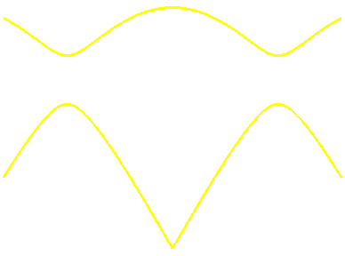
Dispersion
ω
Optical branch
k=0
k=π/a
Acoustical branch
−π/a
0
π/a
k=π/a
k
k=0

Slide 13
Relevant values for k
Solutions for k and for k+h·2π/a
have the same frequency
have the same wavefunctions
Are identical

Slide 14
Group velocity
k ≈ 0
Sound velocity
k ≈ ±π/a
ω(k) ≈ constant: Standing wave

Slide 15

Three dimensions
3-dimensional crystal: 3 degrees of freedom per atom
s atoms per primitive cell: 3 acoustical branches
3s-3 optical branches
ω
Optical modes
Longitudinal:
Acoustical modes
Transverse:
−π/a
0
π/a
k

Slide 16
Sound waves
Longitudinal
Acoustical
Transverse
acoustical

Slide 17
Optical waves
λ
Longitudinal
optical phonons
λ
Transversal
optical phonons

Slide 18
Dispersion in two dimensions
ω(k)
k_{y}
k_{x}

Slide 19
phonons
Classical: u_{s}(t) = u_{k}(t) e^{i kas}
EOM: with
Quantum states of elastic waves:
V(u)
3
2
1
0
u
See kittel appendix C: quantization of elastic waves: phonons

Slide 20
Properties of phonons
Any number can occupy the same vibrational mode u_{k}
Phonons are bosons
Thermal occupation given by Planck’s distribution
Zero-point energy:
Energy of 1 phonon:
“Momentum” of 1 phonon:
Phonons: Quantum excitations of solids

Slide 21
Measuring phonons
1 eV
Optical
1 meV
Log(ν[Hz])
Photons
INS
Raman/Brillouin
IR/FIR
EELS
IMBS
Ultrasound
X-ray
Point/Tunnel
Electrons
Neutrons
He-atoms
Ultrasound
Acoustic
1 Å
Log(k[Å⁻¹])
Notes:
IMBS = inelastic molecular beam scattering

Slide 22
Phonon momentum
Total momentum of a crystal with phonon k is zero !
neutron in
Energy conservation
phonon out
“Momentum” conservation
neutron out

Slide 23
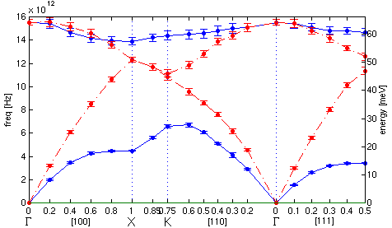
Phonon dispersion in Si

Slide 24
Inelastic phonon scattering
Polarization response
Phonons modulate susceptibility
Dipole radiation at
Rayleigh scattering and Raman sidebands
Ratio anti-Stokes and Stokes intensity

Slide 25
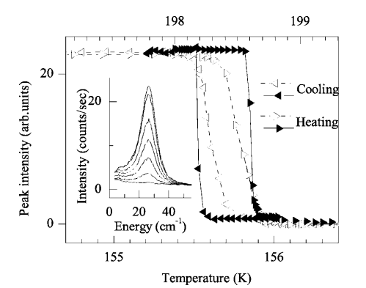
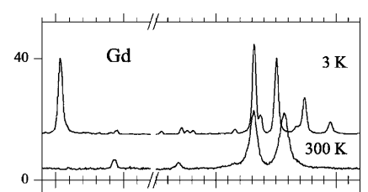
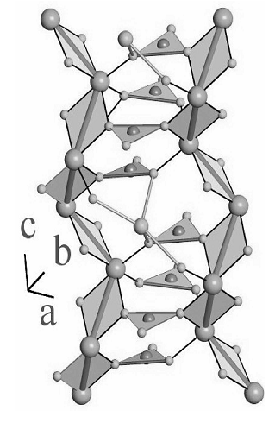

Raman scattering
Vibrational spectroscopy
Symmetry
Phase transitions
Coupling to other excitations
Bond specific (chemical composition)
Temperature (ratio stokes/ant-stokes)
First order phase transition in RFe₃(BO₃)₄
D. Fausti et al., PRB 74, 024403 1996

Slide 26
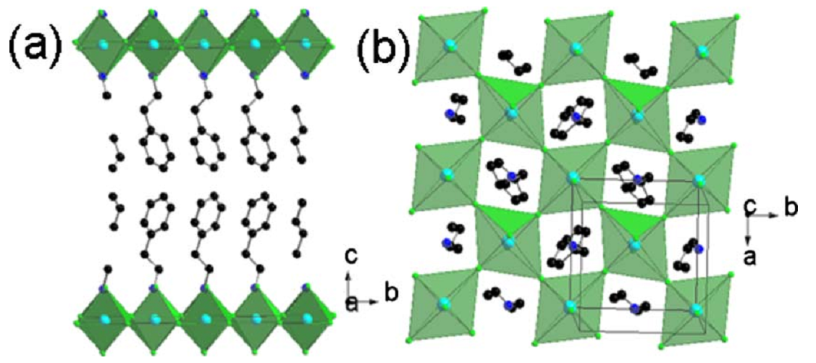
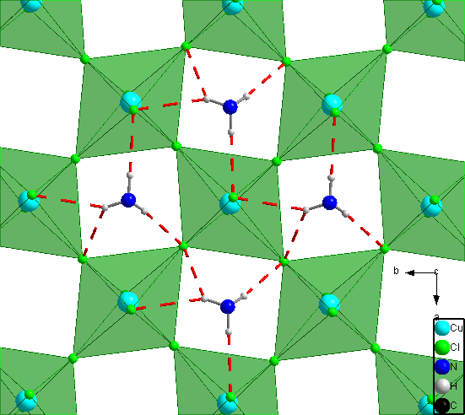
Hybrids: Orientational melting

Slide 27
Harmonic crystal:
No thermal expansion
a
u_{j}
Harmonic
V(u)
u
No lattice expansion !!

Slide 28
Anharmonicity:
Thermal expansion (classical)
a
u_{j}
Weak anharmonicity
V(u)
u
Lattice expansion is caused by anharmonicity !

