Slide 1
Condensed Matter Physics I
Prof. Dr. Ir. Paul H.M. van Loosdrecht
II Physikalisches Institut, Room 312
E-mail: pvl@ph2.uni-koeln.de
Website: http:/www.loosdrecht.net/

Slide 2
Previously
Free electron model
Density of states, Fermi-Dirac distribution
Pressure, Bulk modulus, Heat capacity,
Thermal mass

Slide 3
Today
Transport
Failures of the free electron model
Incorporating periodicity

Slide 4
Electrical conductivity
2nd Newton: or
δk
Relaxation time τ: δk 0
k
k’
e-p,e-e scattering (appendix J, Ch. 10)
Impurity scattering
F
Equation of motion:

Slide 5
Electrical conductivity
k_{y}
E
k_{x}

Slide 6
Electrical conductivity
k_{y}
E
k_{x}

Slide 7
Ohm’s law
F = qE
σ ⁻¹
Current density
Ohm’s law
T
Very pure metals, low T:
Notes:
Scattering phonons, impurities. Matthiessen’s rule; low T temperature dependence (#phonons)
Residual resistance ratio;

Slide 8
Resistance of potassium
at 20 K for two different
samples.
Residual resistance ration RRR
An impurity causes a residual
resistance of:

Slide 9
Temperature dependence of the electric resistance
Very low temperatures
ρ_{Phonon}∝ T⁵/ Θ_{D}⁵
Umklapp-processes are not possible
for T<2K in the case of K
(2) Low temperatures
Umklapp-processes become possible
<n> ∝ e^{-ΘU/T} characteristic Umklapp-temperature
Potassium: ΘU=23K; Θ_{D}=91K
(3) High temperatures
<n> ∝ T ➔ ρ_{Phonon}∝ T
(4) Very high temperatures
saturation as the phonon scattering cannot lead to mean free path-lengths
shorter than the lattice constant (Ioffe rule)

Slide 10
The resistance roughly scales with the Debye temperature !

Slide 11
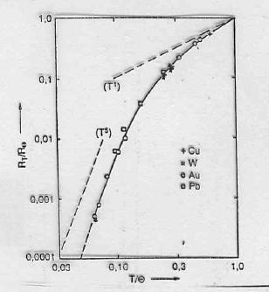
Transition from T⁵ to T behavior !

Slide 12
Matthiessen rule: alloys➔ vertical displacement of ρ(T) curves

Slide 13
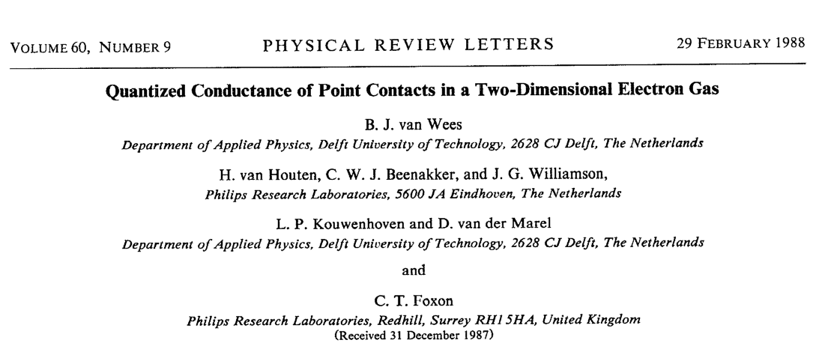
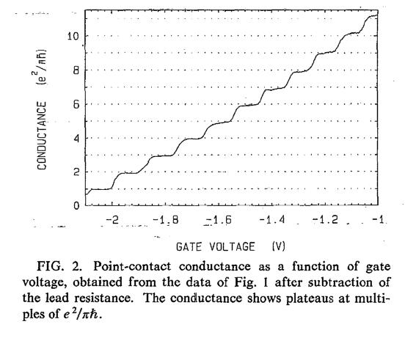
1D conduction

