Slide 1
Condensed Matter Physics I
Prof. Dr. Ir. Paul H.M. van Loosdrecht
II Physikalisches Institut, Room 312
E-mail: pvl@ph2.uni-koeln.de
Website: http:/www.loosdrecht.net/

Slide 2
Previously
Free electron model
Density of states, Fermi-Dirac distribution
Pressure, Bulk modulus, Heat capacity, Thermal mass
Charge conductivity
Classical Hall effect
Electronic thermal transport, Wiedemann-Franz
Failures of free e- model
Incorporation periodic potential, Bloch states, gaps

Slide 3
Today

Slide 4
Band structure: Approaches
Empty lattice (only periodicity)
Perturbation theory (nearly free electrons, weak potential)
Tight binding method (LCAO)
Exact models (Kronig-Penney model, see for instance Kittel)
‘advanced’ methods: see for instance ashcroft and mermin, chapter 11

Slide 5
Diamond band structure

Slide 6
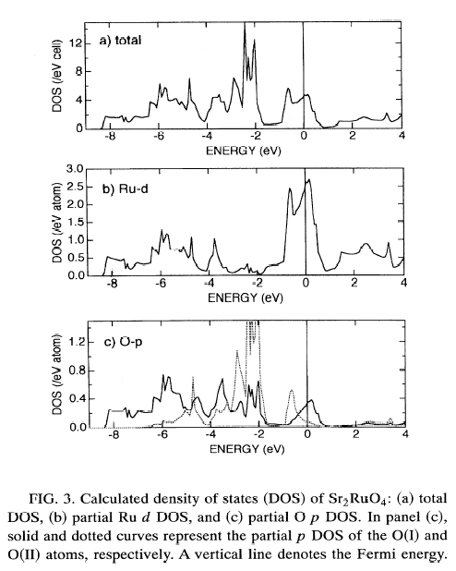
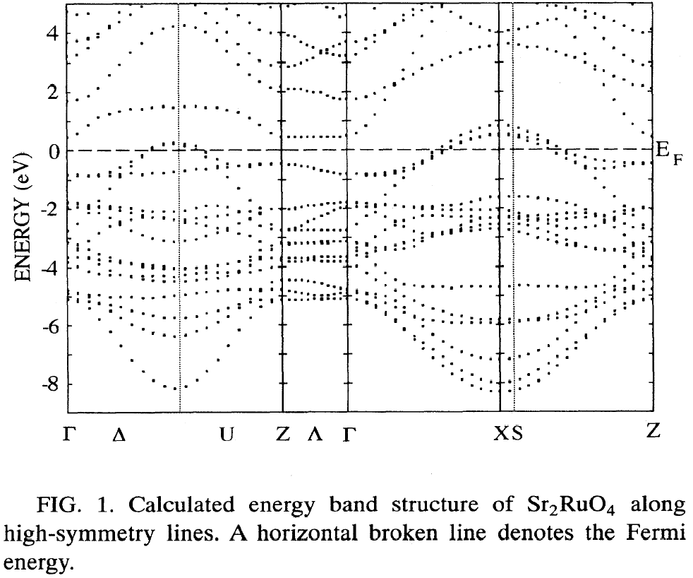
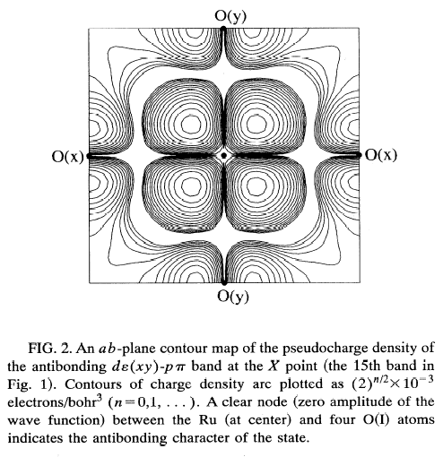
Sr2RuO4

Slide 7
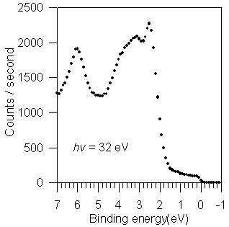
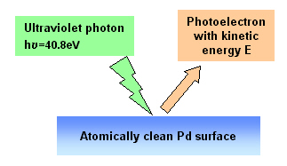
Photoemission
$$E_{bind}=ℏω −E_{kin}−φ$$
$$ℏk_{||}^{i}=ℏk_{||}^{f}=\sqrt{2mE_{kin}}\sin{θ}$$
Gold, U. Johansson, R. Nyholm

Slide 8
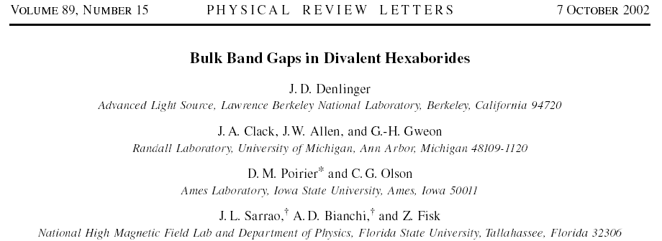
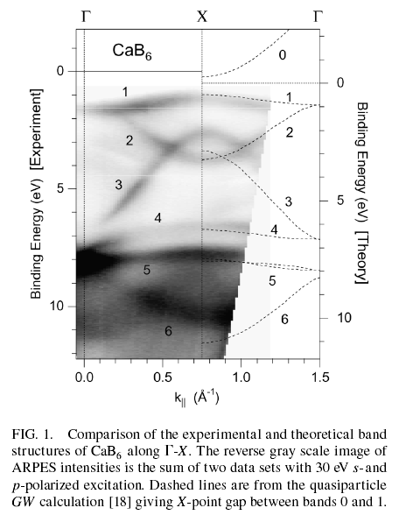
Photoemission

Slide 9
Photoemission

Slide 10
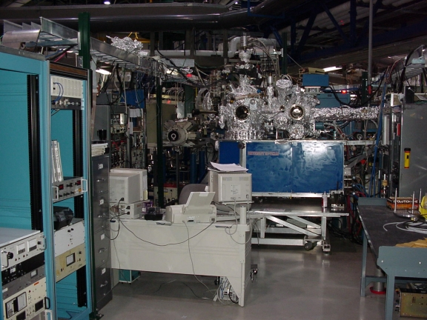
Photoemission

Slide 11
Band Structure
Continued

Slide 12
Bloch theorem
Bloch Theorem
The eigenstates of a periodic one-electron Hamiltonian can be chosen to have the form of
a plane wave times a function with the periodicity
of the Hamiltonian

Slide 13
Remarks on Blochfunctions
Quantum number k: Crystal momentum
k may be confined to the 1st BZ (Reduced BZ)
Band index n Born-von Karman
Band structure

Slide 14
Band structure: Approaches
Last time
Empty lattice (only periodicity)
Perturbation theory (nearly free electrons, weak potential)
Today
Tight binding method (LCAO)
Other methods
Exact models (Kronig-Penney model, see book)
‘advanced’ methods: Ashcroft & Mermin chapter 11

Slide 15
Tight binding approach
E
H=H_{at}
H=H_{at} + V(r)
1
2
3
4
5
6
7
8
9
ρ/a₀

Slide 16
Tight binding
Atomic orbitals ϕ(r) : H_{at} ϕ(r) = E_{at} ϕ(r)
Solid state: H = H_{at} + V(r)
1st order correction to energy: diagonal elements

Slide 17
Tight binding
Only nearest neighbours:
Self
N.N.

Slide 18
Tight binding
S.C.: n.n. at (±a, 0, 0); (0, ±a, 0); (0, 0, ±a)
ε(k) = −α − 2γ [ cos(k_{x}a) + cos(k_{y}a) + cos(k_{z}a) ]
E
−α
4γ in the (100) dir.
(k_{x},0,0)

Slide 19
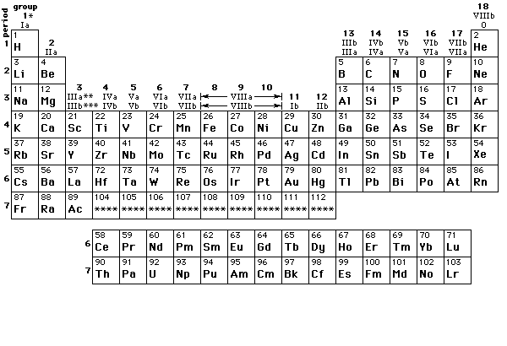
Tight binding
TB method: Insulators and core electrons and d-electrons in transition metals (e.g. Cu, V, Ti etc.).
Nearly free electron model: conduction electrons, s or p, alkali (e.g. Na, K, etc.)

Slide 20
Reduced Brillouin zone
E
−3π/a
−π/a
π/a
3π/a
k

Slide 21
Extended zone scheme
E
2G
-2G
G
-G
−3π/a
−π/a
π/a
3π/a
k

Slide 22
Reduced zone scheme
E
−π/a
π/a
k

Slide 23
Periodic zone scheme
E
−3π/a
−π/a
π/a
3π/a
k

Slide 24
Bandstructure
Why are not all solids metals
Why is diamond an insulator
Why is copper a metal
Why does the conductivity of Si increase upon heating
Insulators
Semicond’s
Metals
Fused silica
Germanium
Iron
Copper
Diamond
Silicon
glass
10⁻²⁰
10⁻¹⁶
10⁻¹²
10⁻⁸
10⁻⁴
10⁰
10⁴
10⁸
Conductivity (Ω⁻¹cm⁻¹)

Slide 25
Conductivity
E
C
V
−π/a
π/a
k
Insulator
Metal
p-Doped
Semi-
Conductor
n-Doped
Semi-
Conductor

Slide 26
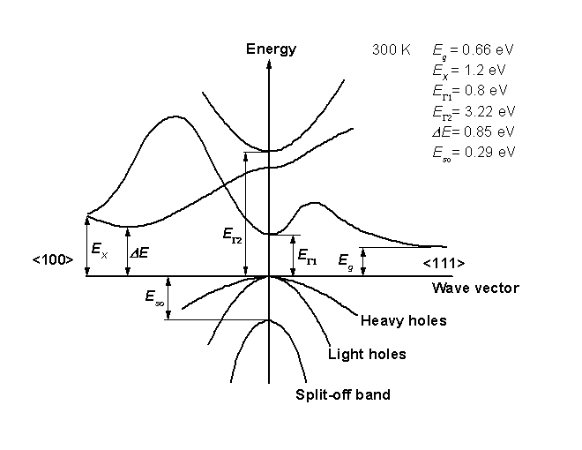
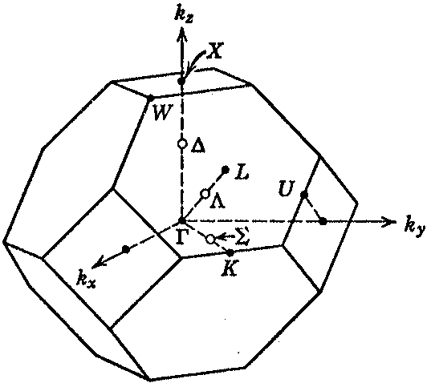
Diamond and Germanium
Germanium (E_{g}=0.7 eV)
Diamond (E_{g}=5.5 eV)

Slide 27
Bandfilling & overlap
E
E
E
Ti 3d (e_{g})
V 3d (e_{g})
Ti 3d (e_{g})
Ti 3d (t_{g})
Ti 3d (t_{g})
V 3d (t_{g})
O 2p
S 3p
O 2p
DOS
DOS
DOS
TiO₂
Empty d-bands
VO₂
Partially filled d-bands
TiS₂
Overlapping bands
Ti: [Ar]3d²4s²
V: [Ar]3d³4s²

Slide 28
Band gap in some materials
E_{g}(eV)
Diamond I 5.4
Si I 1.17
Ge I 0.74
GaAs d 1.52
GaSb d 0.81
Te d 0.33
ZnO 3.44
Cu₂O d 2.17
CdTe d 1.6
TiO₂ 3.03
Conduction
Forbidden
E_{g}
Valence
Direct & indirect
Optical absorption

