Slide 1
Condensed Matter Physics II SS 2015
Wednesday 9:30-12:30
Seminar Room Physics 2
Prof. Paul H.M. van Loosdrecht
pvl@ph2.uni-koeln.de
www.loosdrecht.net

Slide 2
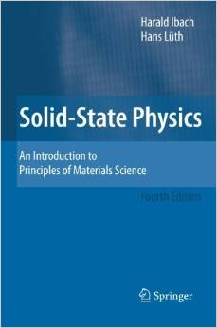
Literature
Basic solid state physics book:
Ashcroft and Mermin
Kittel
Ibach Luth

Slide 3
Images and Tables
Many of the images used in the lectures originate from the web, in particular
sites like
Wikipedia
Hyperphysics
Superconductors.org
turn out to be useful (but are not the only ones)

Slide 4
Preliminary Schedule
1 8-Apr-15 PvL Superconductivity
2 15-Apr-15 PvL Superconductivity
3 22-Apr-15 PvL Superconductivity
4 29-Apr-15 PvL Ordering phenomena
5 6-May-15 PvL Ordering phenomena
6 13-May-15 PvL Ordering phenomena
20-May-15 IV Dielectrics and ferroelectrics, multiferroics
27-May-15 IV Thin film physics
9 3-Jun-15 IV Thin film fabrication techniques
10 10-Jun-15 PvL Transport
11 17-Jun-15 PvL Transport
12 24-Jun-15 PvL NMR/ESR
13 1-Jul-15 PvL Magneto-optical properties
14 8-Jul-15 PvL Bose Einstein condensation
15 15-Jul-15 PvL Thermo-electrics

Slide 5
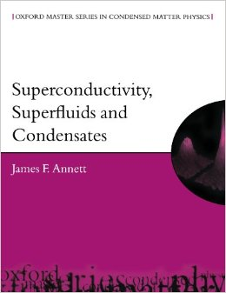
Literature superconductivity
Solid state physics books
PLUS

Slide 6
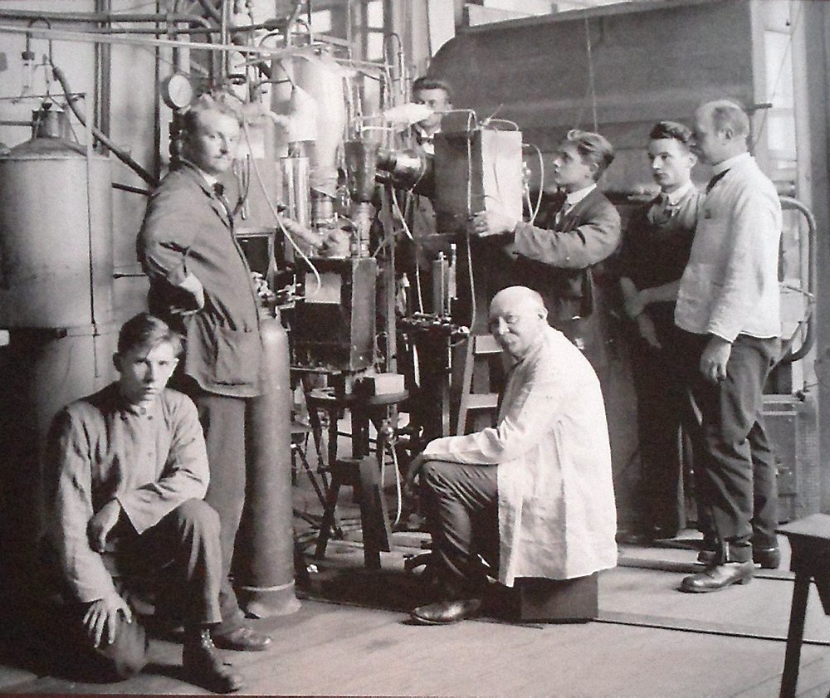
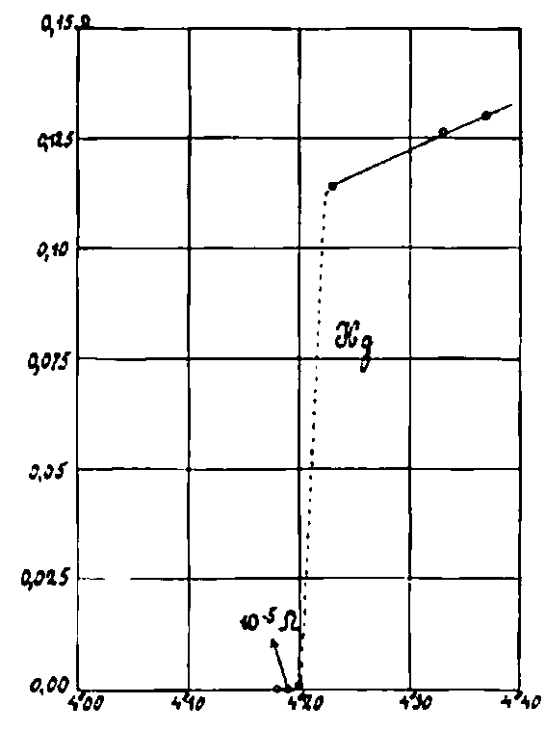
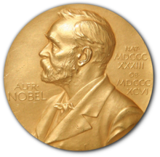
Superconductivity
Gillis Holst
Heike Kamerlingh Onnes
1908 Liquid Helium
1911 Superconductivity
1913 Nobel Prize

Slide 7
Superconductivity: Nobel prizes
The Nobel Prize in Physics 1913 "for his investigations on the properties of matter at low temperatures which led, inter alia, to the production of liquid helium" Heike Kamerlingh Onnes The Nobel Prize in Physics 1972 "for their jointly developed theory of superconductivity, usually called the BCS-theory" John Bardeen Leon Neil Cooper John Robert Schrieffer The Nobel Prize in Physics 1973 "for [his] experimental discoveries regarding tunneling phenomena in ... superconductors" (Leo Esaki,) Ivar Giaever "for his theoretical predictions of the properties of a supercurrent through a tunnel barrier, in particular those phenomena which are generally known as the Josephson effects" Brian David Josephson The Nobel Prize in Physics 1987 "for their important break-through in the discovery of superconductivity in ceramic materials" J. Georg Bednorz K. Alexander Müller The Nobel Prize in Physics 2003 "for pioneering contributions to the theory of superconductors and superfluids" Alexei A. Abrikosov Vitaly L. Ginzburg Anthony J. Leggett

Slide 8
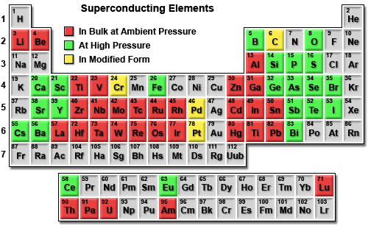
Superconducting elements
All < 10 K, most (well) below 5 K
highest: Nb (Type II, 9.6 K)

Slide 9
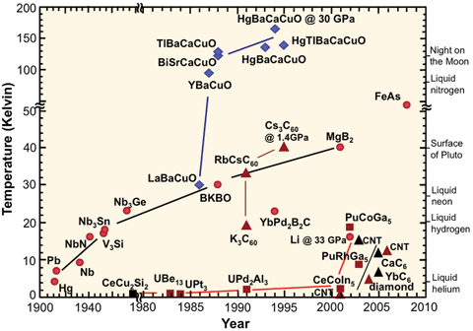
Superconductors: Timeline
Notes:
Also mention A3C60; MgB2; FeAs

Slide 10
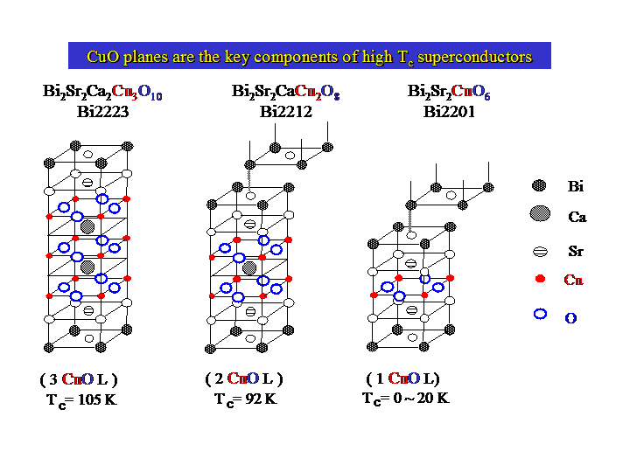
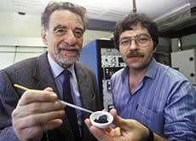
High temperature superconductivity

Slide 11
High Tc superconductors
Critical temperature (Tc), crystal structure and lattice constants of some high-Tc superconductors
Formula | Notation | T_{c} (K) | No. of Cu-O planes in unit cell | Crystal structure
YBa₂Cu₃O₇ | 123 | 92 | 2 | Orthorhombic
Bi₂Sr₂CuO₆ | Bi-2201 | 20 | 1 | Tetragonal
Bi₂Sr₂CaCu₂O₈ | Bi-2212 | 85 | 2 | Tetragonal
Bi₂Sr₂Ca₂Cu₃O₆ | Bi-2223 | 110 | 3 | Tetragonal
Tl₂Ba₂CuO₆ | Tl-2201 | 80 | 1 | Tetragonal
Tl₂Ba₂CaCu₂O₈ | Tl-2212 | 108 | 2 | Tetragonal
Tl₂Ba₂Ca₂Cu₃O₁₀ | Tl-2223 | 125 | 3 | Tetragonal
TlBa₂Ca₃Cu₄O₁₁ | Tl-1234 | 122 | 4 | Tetragonal
HgBa₂CuO₄ | Hg-1201 | 94 | 1 | Tetragonal
HgBa₂CaCu₂O₆ | Hg-1212 | 128 | 2 | Tetragonal
HgBa₂Ca₂Cu₃O₈ | Hg-1223 | 134 | 3 | Tetragonal
Hg-1223: 153 K under pressure

Slide 12
New record (???)
Conventional superconductivity at 190 K at high pressures
A.P. Drozdov, M. I. Eremets, I. A. Troyan
(Submitted on 1 Dec 2014)
The highest critical temperature of superconductivity Tc has been achieved in cuprates: 133 K at ambient pressure and 164 K at high pressures. As the nature of superconductivity in these materials is still not disclosed, the prospects for a higher Tc are not clear. In contrast the Bardeen-Cooper-Schrieffer (BCS) theory gives a clear guide for achieving high Tc: it should be a favorable combination of high frequency phonons, strong coupling between electrons and phonons, and high density of states. These conditions can be fulfilled for metallic hydrogen and covalent hydrogen dominant compounds. Numerous followed calculations supported this idea and predicted Tc=100-235 K for many hydrides but only moderate Tc~17 K has been observed experimentally. Here we found that sulfur hydride transforms at P~90 GPa to metal and superconductor with Tc increasing with pressure to 150 K at ~200 GPa. This is in general agreement with recent calculations of Tc~80 K for H2S. Moreover we found superconductivity with Tc~190 K in a H2S sample pressurized to P>150 GPa at T>220 K. This superconductivity likely associates with the dissociation of H2S, and formation of SHn (n>2) hydrides. We proved occurrence of superconductivity by the drop of the resistivity at least 50 times lower than the copper resistivity, the decrease of Tc with magnetic field, and the strong isotope shift of Tc in D2S which evidences a major role of phonons in the superconductivity. H2S is a substance with a moderate content of hydrogen therefore high Tc can be expected in a wide range of hydrogen-contain materials. Hydrogen atoms seem to be essential to provide the high frequency modes in the phonon spectrum and the strong electron-phonon coupling.
arXiv:1412.0460 (http://arxiv.org/abs/1412.0460)

Slide 13
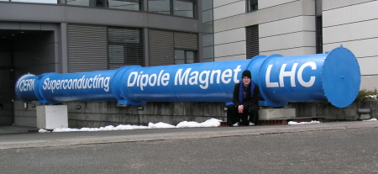
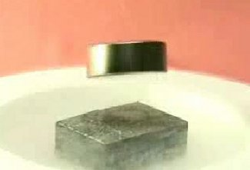
Superconductors: Main properties
Macroscopic quantum phenomenon
Vanishing resistance → Kamerlingh Onnes
Perfect diamagnet → Meissner-Ochsenfeld effect
Type I and type II superconductors
2nd order phase transition → Thermodynamics (Heat cap.)
Electronically gapped state → Tunneling spectroscopy, optics
Isotope effect: Role of phonons? → Isotope experiments
Unit of charge ‘responsible particle’ is 2e → Flux quantization

Slide 14
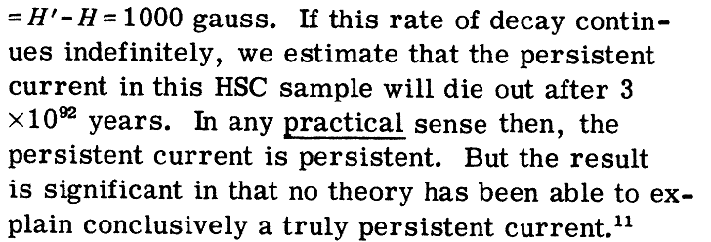
Zero resistance
Expts. on 3Nb-Zr alloys

Slide 15
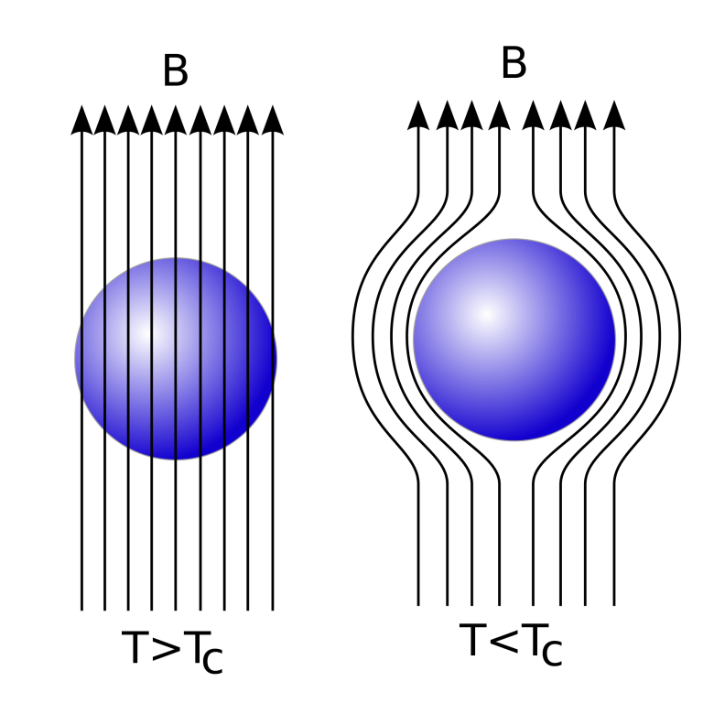
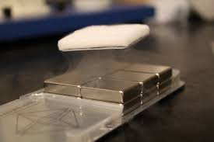
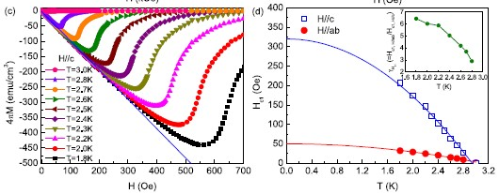
Meissner-Ochsenfeld effect
Figure Ni_{0.05}ZrTe₃ : (c) Low-field parts of M(H) at various temperature for H||c with demagnetization correct, respectively. (d) Temperature dependence of H_{c1} for H||ab and H||c. The dashed lines are the fitted lines using H_{c1} = H_{c1}(0)(1 − (T/T_{c})²). [Lei et al. 2011]

Slide 16
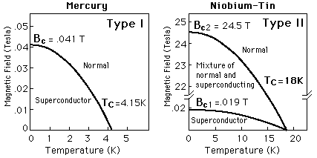
Type I & II superconductors

Slide 17
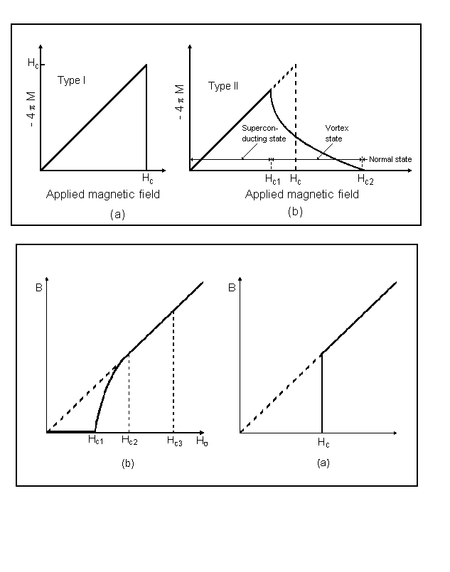
Type I & II superconductors
Magnetization M
Magnetic induction B

Slide 18
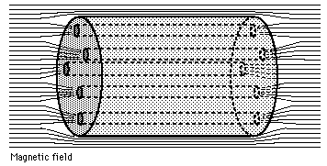
Type II superconductors
TYPE II
(shubnikov phase)
TYPE I

Slide 19
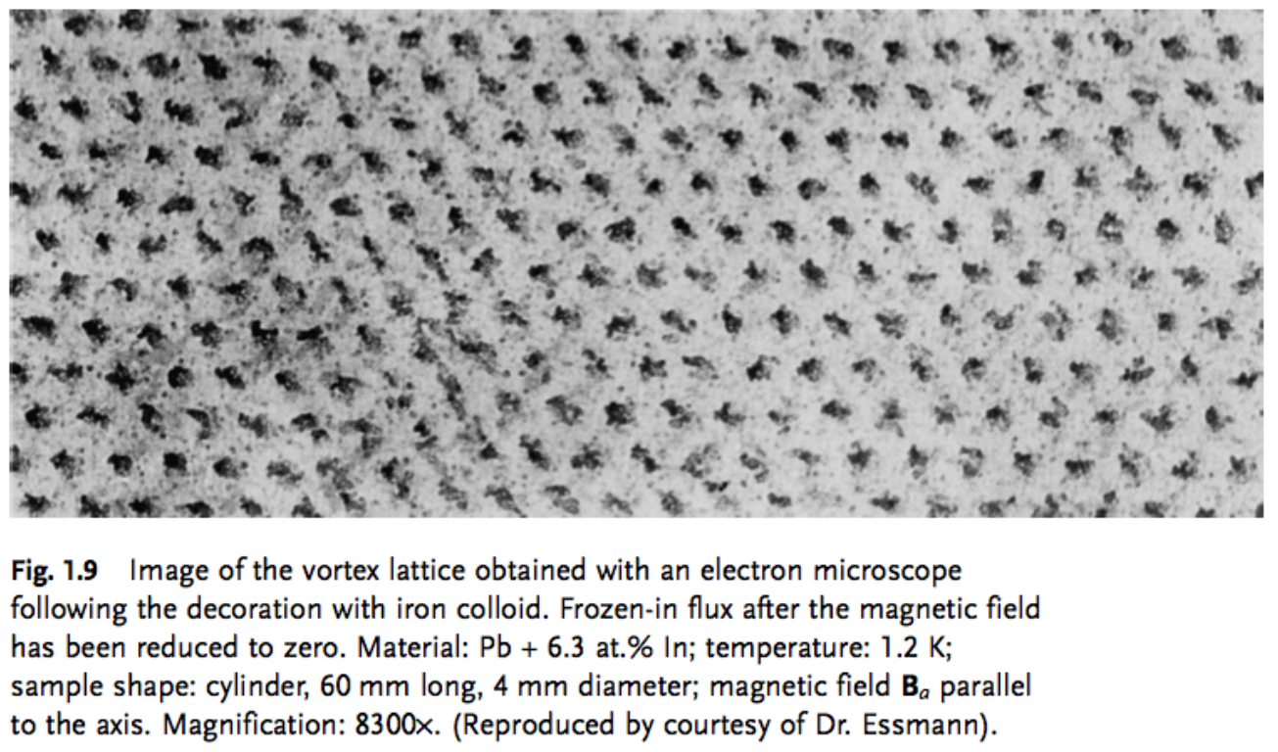
Flux lines, Abrikosov lattice
Lattice: 1-100 nm

Slide 20
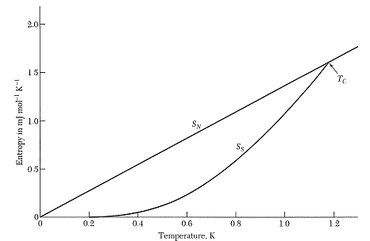
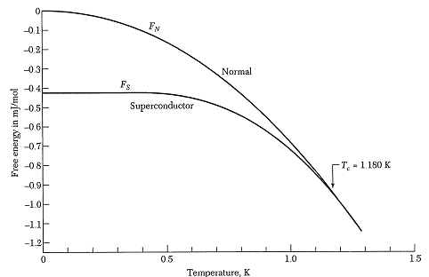
Second order phase transition
Aluminum
Since less entropy: SC state more ordered !!
What orders ???
ΔS ~ 10^{–4} k_{B} per atom
→ only 10^{–4} e’s participate in transition.
Notes:
Normal state: F=U-TS=U-gamma T^2

Slide 21
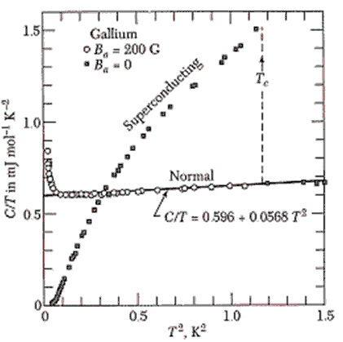
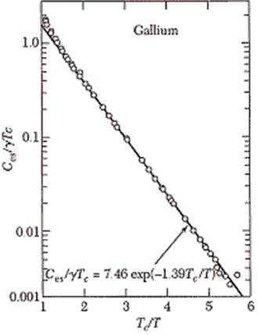
Heat capacity → energy gap

Slide 22
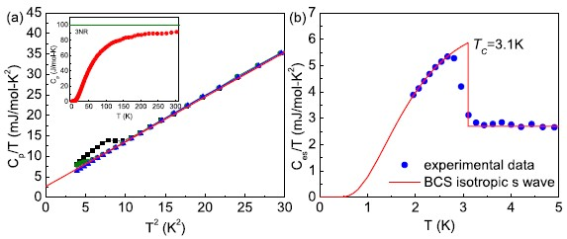
Type II specific heat
(a) Low-temperature specific-heat behavior of Ni_{0.05}ZrTe₃ plotted as C_{p}/T vs. T at H = 0, 1 and 50 kOe. The solid line is a fit described in the text. Inset: temperature dependence of C_{p}(T) from 1.95 K to 300 K at H = 0 kOe. (b) Temperature dependence of the electronic specific heat plotted as C_{es}/T vs. T at H = 0 kOe. The solid line shows fitted result of C_{es}/T assuming an isotropic s-wave BCS gap. [Lei et al. 2011]

Slide 23
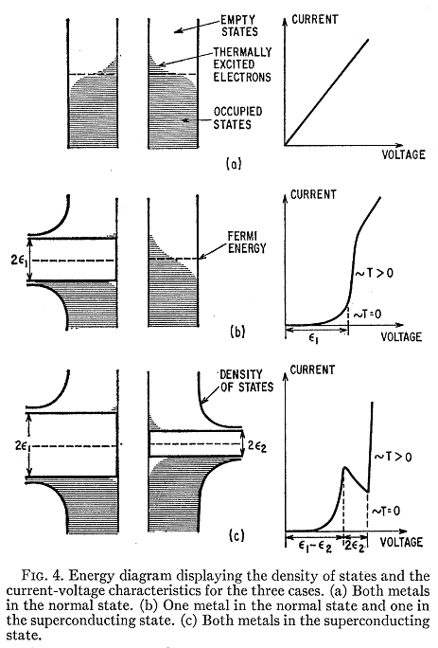
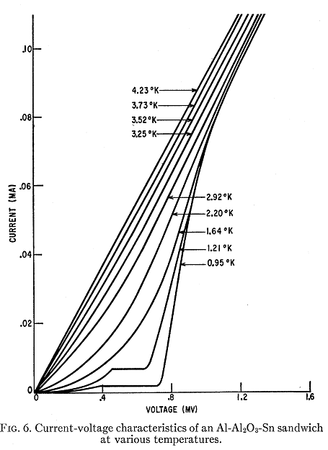
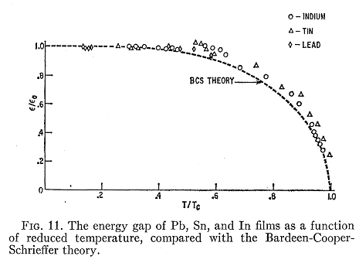
Superconducting gap
Tunneling (Giaever et al., 1961)
Optics (Hwang et al., 2007)

Slide 24
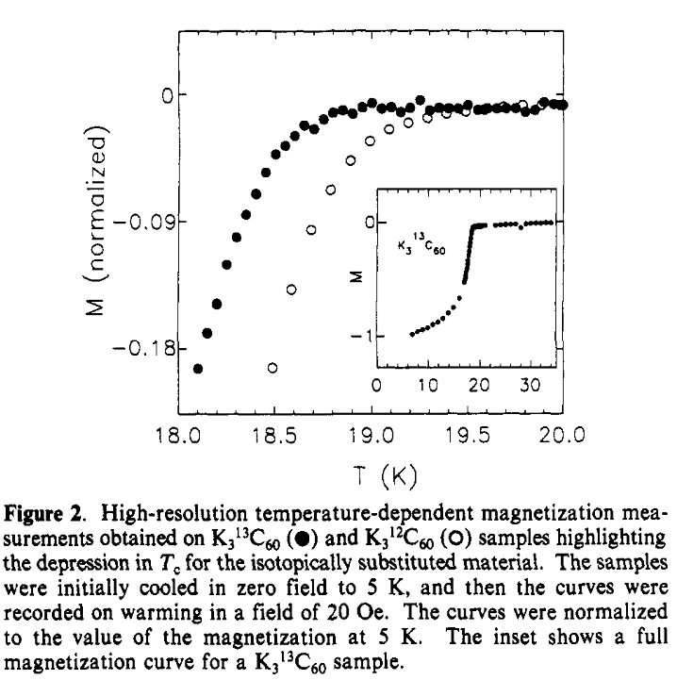
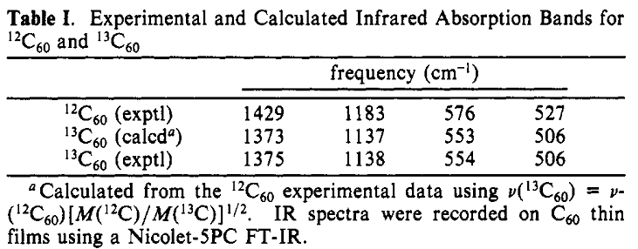
Isotope effect

Slide 25
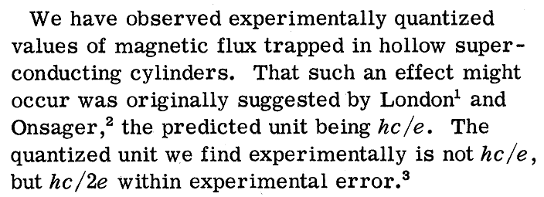
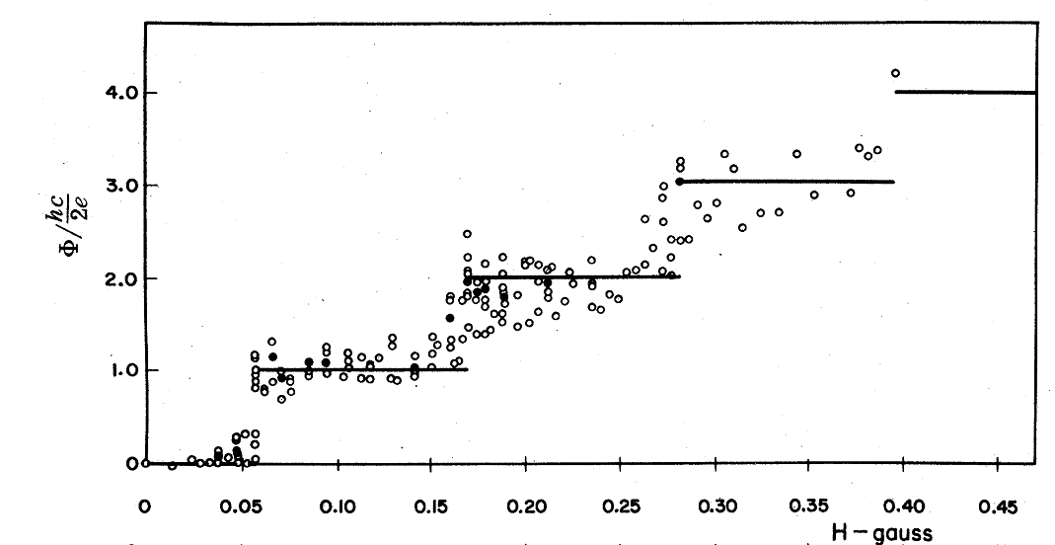
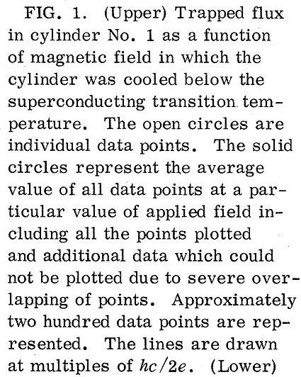
Flux quantization

