Slide 1
Condensed Matter Physics II SS 2015
Wednesday 9:30-12:30
Seminar Room Physics 2
Prof. Paul H.M. van Loosdrecht
pvl@ph2.uni-koeln.de
www.loosdrecht.net

Slide 2
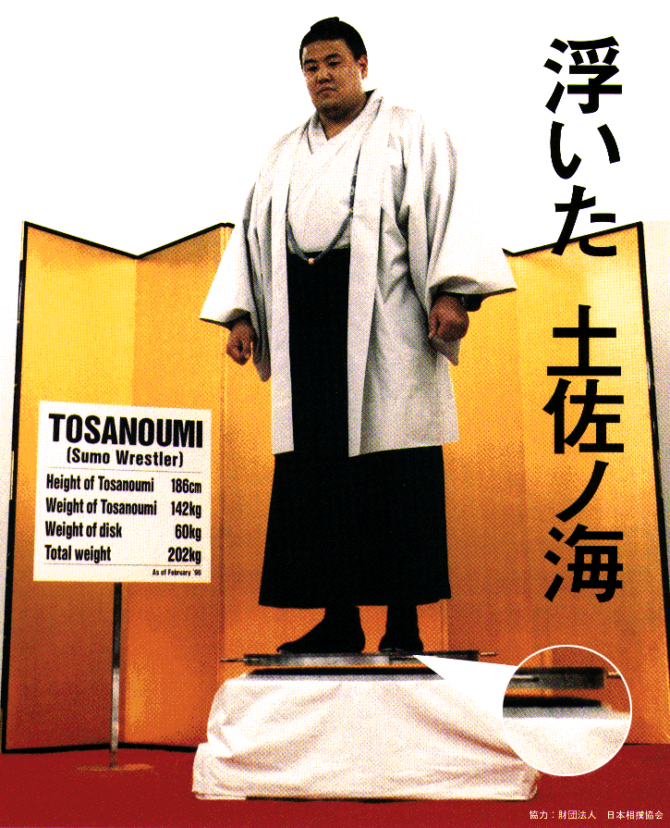
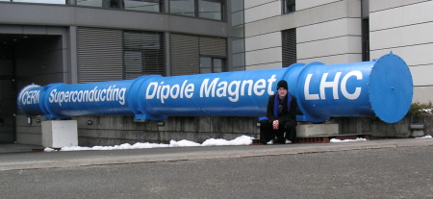
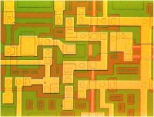
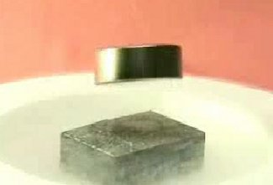
Last time: Superconductors: Main properties
Macroscopic quantum phenomenon
Vanishing resistance → Kamerlingh Onnes
Perfect diamagnet → Meissner-Ochsenfeld effect
Type I and type II superconductors
2nd order phase transition → Thermodynamics (Heat cap.)
Electronically gapped state → Tunneling spectroscopy, optics
Isotope effect: Role of phonons? → Isotope experiments
Unit of charge ‘responsible particle’ is 2e → Flux quantization

Slide 3
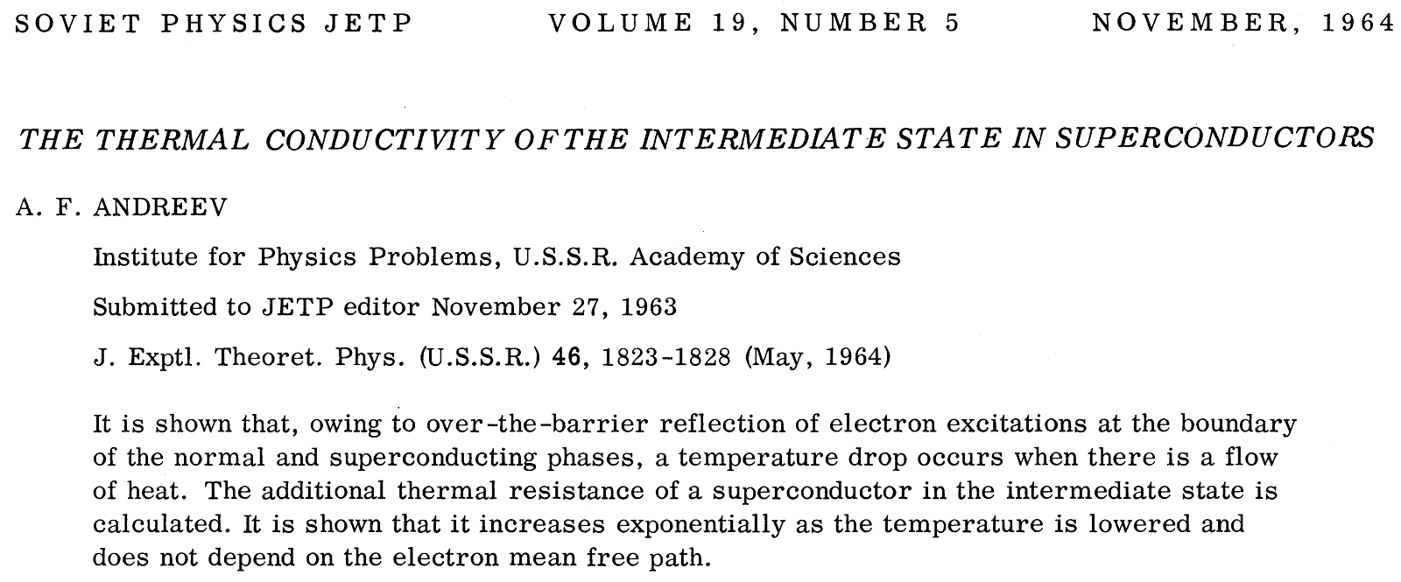
One more experiment showing ‘pairing’

Slide 4
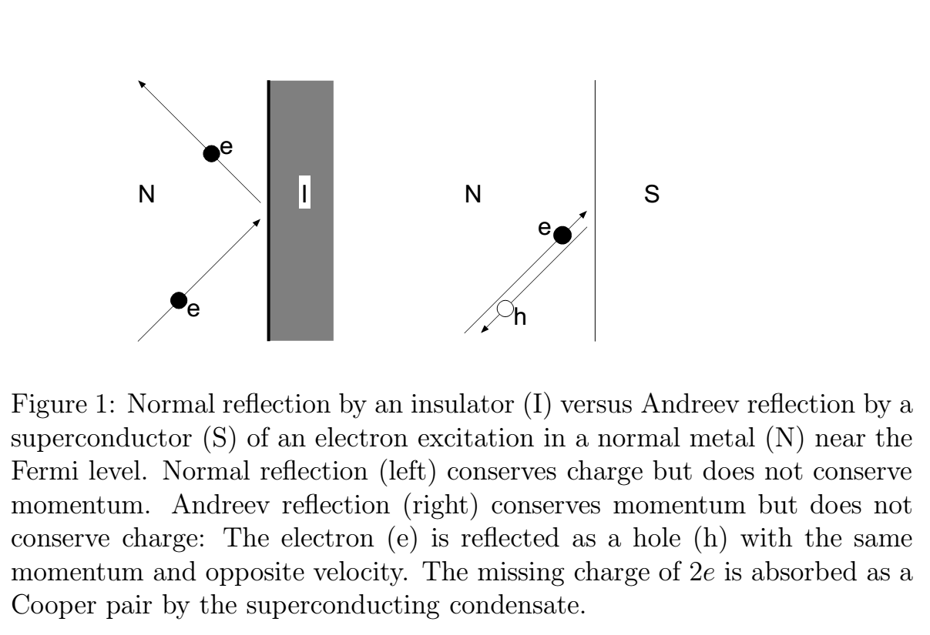
Transport through a N-S interface
From Beenakker, ArXiv 9909293

Slide 5
Point contact conductance

Slide 6
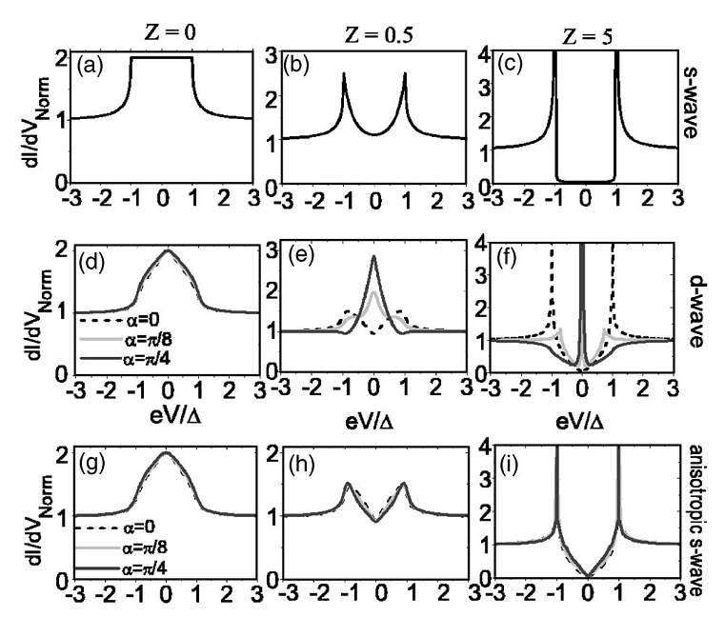
Point contact & tunneling
From Piano et al. PRB 2006

Slide 7
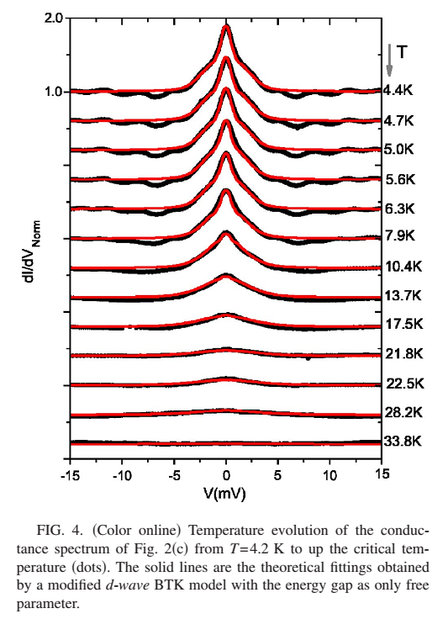
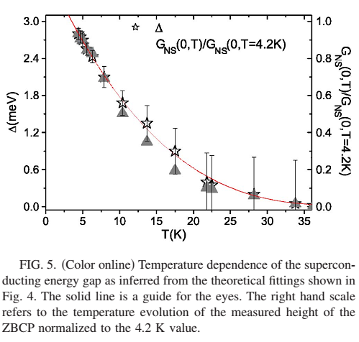

Slide 8
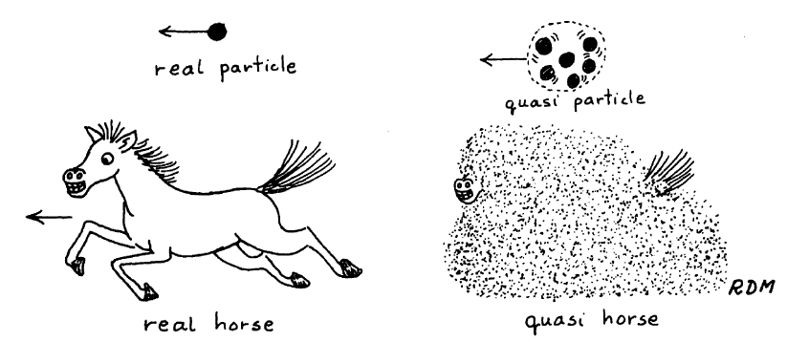
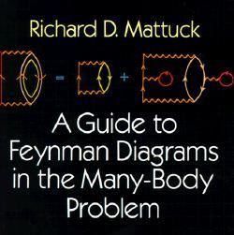
Quasi-particles

