Slide 1
Condensed Matter Physics II SS 2015
Wednesday 9:30-12:30
Seminar Room Physics 2
Prof. Paul H.M. van Loosdrecht
pvl@ph2.uni-koeln.de
www.loosdrecht.net

Slide 2
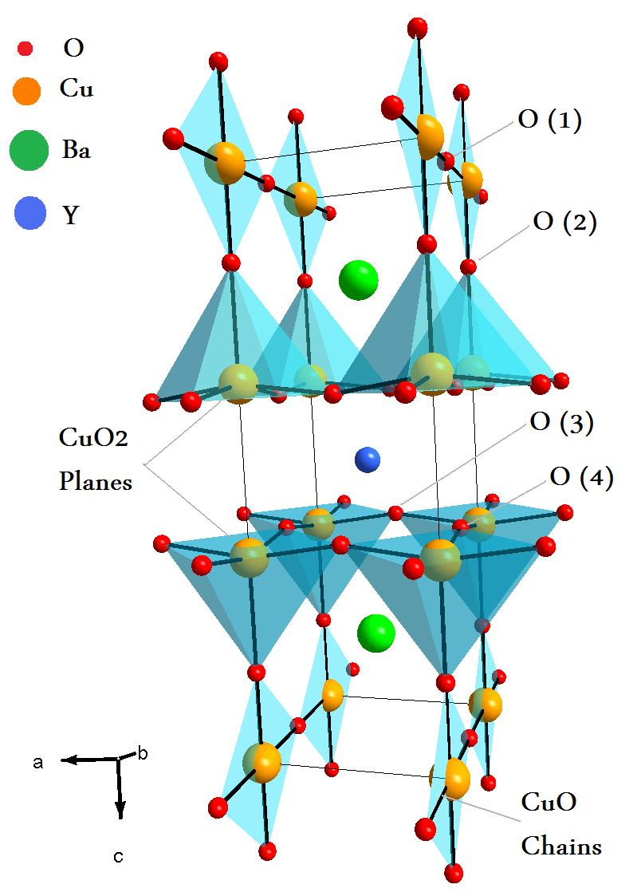
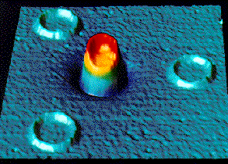
False color scanning SQUID image (red=high B, blue=low B) from John Kirtley, Chang Tsuei and Mark Ketchen of IBM showing the magnetic field in four split YBCO rings. Only the central ring is composed of three junctions, such that in a d-wave superconductor, the three crystal interfaces would lead to a net phase shift of 180 degrees around the ring. This leads to spontaneous currents creating a 1/2 quantum of flux in the ring, as observed.
J.R. Kirtley et al., Nature 373, 225 (1995).

Slide 3
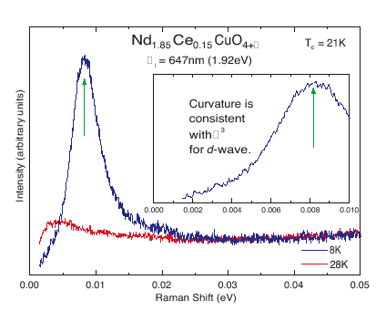
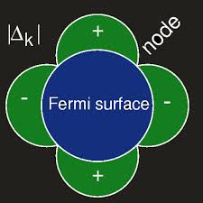
FIGURE 8 The Raman spectrum of Nd1.85Ce0.15CuO4+d measured above and below theT_{c}of 21K. The incident laser energy of 1.92 eV is defined as zero, and only the downward 'red' shift is plotted. The inset expands the low-frequency scale for the 8 K data to accentuate the curvature.
C. Kendziora

Slide 4
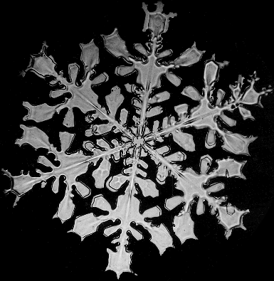
Symmetry
BROKEN SYMMETRY
- Phase transitions (critical behavior, 1st/2nd order)
Rigidity (crystals don’t bend, permanent M) - Excitations (spectral changes, soft mode, order parameter)
Defects (order parameter discontinuity)
What is the difference between phases ?
Density, correlations, symmetry color, magnetization, charge state, etc
Symmetry breaking transitions (solid-liquid)
Liquid: High symmetry
Solid: Few symm. elements kept.
Non-breaking transitions (gas-liquid)
Density
Universality classes depending on
- d, dimension of space
- D, dimension of order parameter
- short/long range order

Slide 5
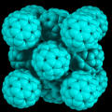
Some examples
Liquid:
Each positions in space occupied (t-average)
High symmetry (all rotations & translations)
Solid:
Few positions occupied
Low symmetry (few rotations & translations)
C₆₀:
High T: FCC
Low T: SC
Magnetic:
High T: No preferred spin direction
Low T : Alignment

Slide 6
Landau theory
ORDER PARAMETER:
Density, Position, Dipole moment,
Magnetization, Occupation number,
Orientation, …
FREE ENERGY
F = E – T·S
E: energy, S: entropy ( S = k_{b}ln(# states) )
LANDAU THEORY
Free energy order parameter expansion
Linearize near T_{c}
Minimize free energy
Mean field approach: correlations or fluctuations not included
Example: Ferromagnet, order parameter: M

Slide 7
Landau theory

Slide 8
Landau theory
Degenerate ground state
Two metastable states
T_{c}
Free energy
Magnetization

Slide 9
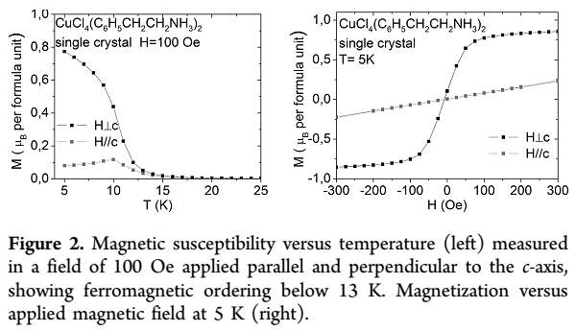
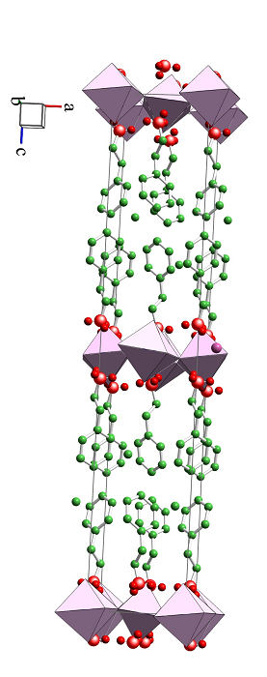
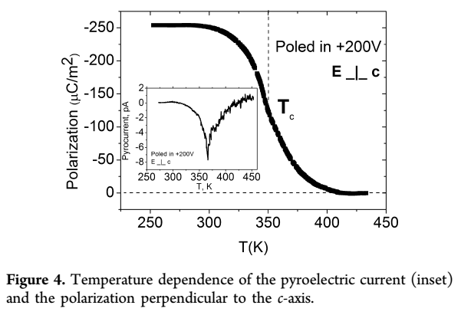
Polyakov et al. Chem. Mat. 2011

Slide 10
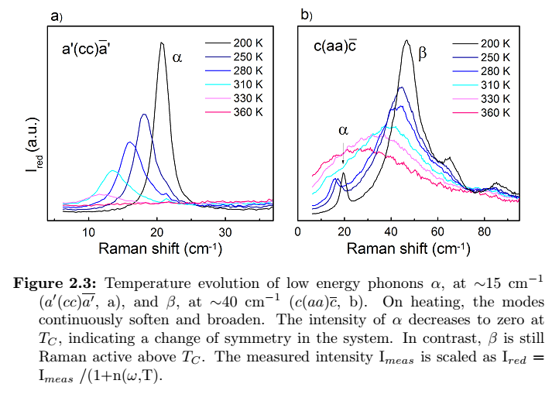
Caretta et al. Phys. Rev. B, 2014

