Slide 1
Condensed Matter Physics II SS 2015
Wednesday 9:30-12:30
Seminar Room Physics 2
Prof. Paul H.M. van Loosdrecht
pvl@ph2.uni-koeln.de
www.loosdrecht.net

Slide 2
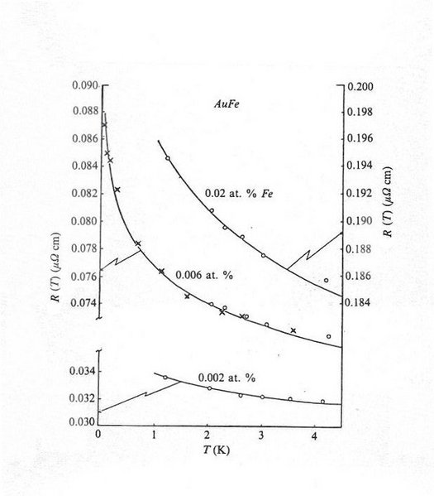
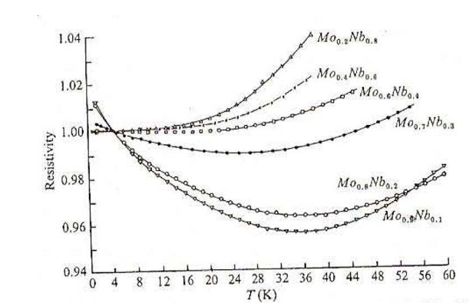
Kondo effect
Kondo, Progress of Theoretical
Physics 32: 37 (1964)
Notes:
41 Nb niobium : [Kr] 4d4 5s1
42 Mo molybdenum : [Kr] 4d5 5s1

Slide 3
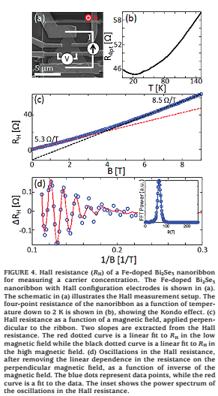
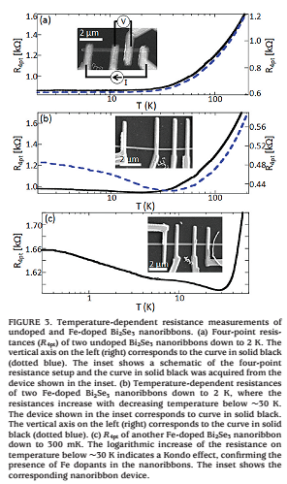

Slide 4
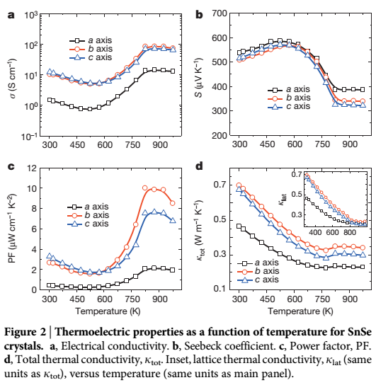
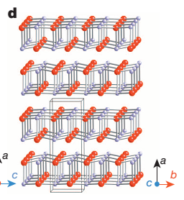
Reasonable
Seebeck coeff.
‘good’ charge conduction
‘bad’ thermal
conduction
Layered material
Anharmonic phonons

Slide 5
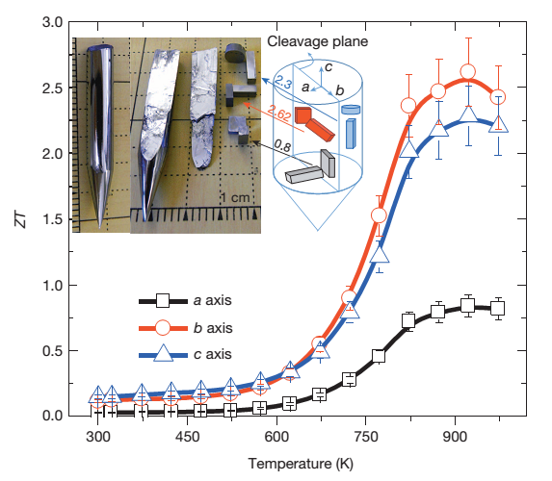
Commonly used:
Bi2Te3: ZT ~ 0.8 at RT
Interest now: TI’s

Slide 6
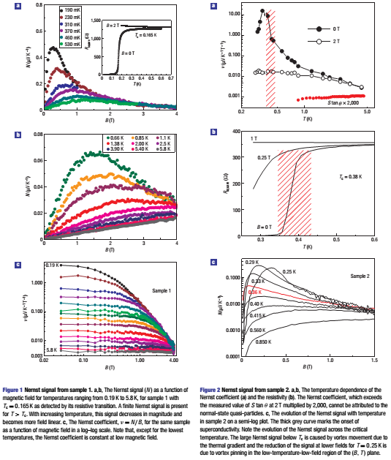
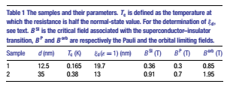

Slide 7
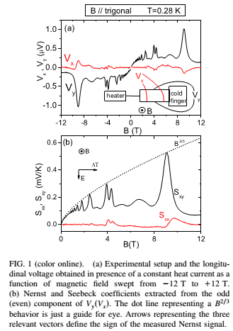
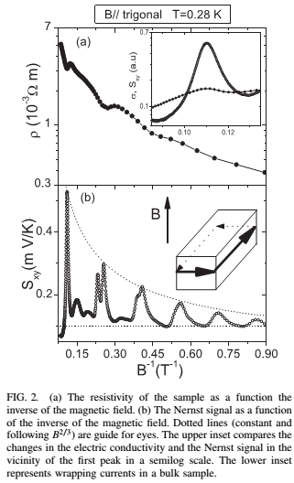
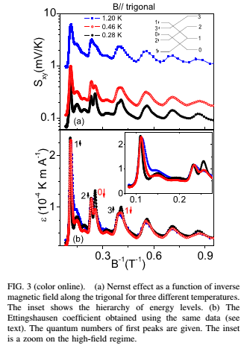

Slide 8
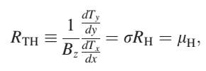
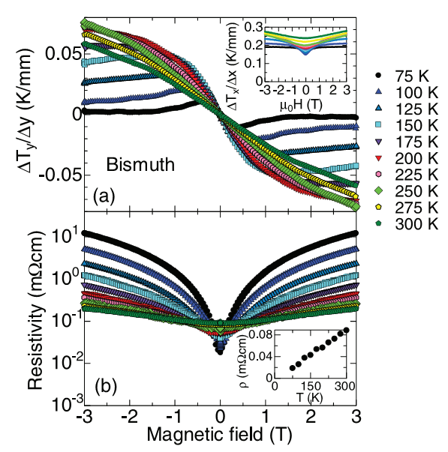
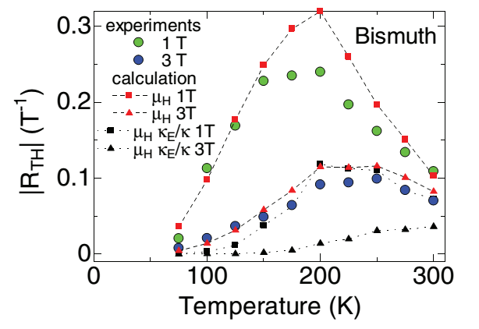
Righi-Leduc effect
metals
Semi-conductors

Slide 9
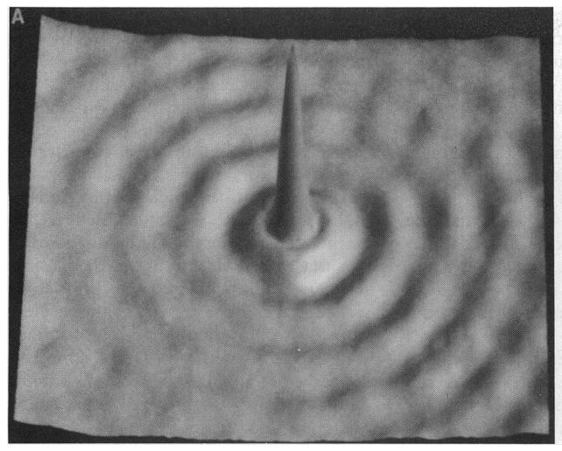
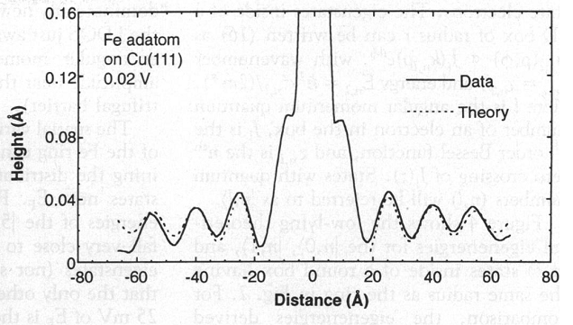

Slide 10
