Slide 1
Condensed Matter Physics II SS 2015
Wednesday 9:30-12:30
Seminar Room Physics 2
Prof. Paul H.M. van Loosdrecht
pvl@ph2.uni-koeln.de
www.loosdrecht.net

Slide 2
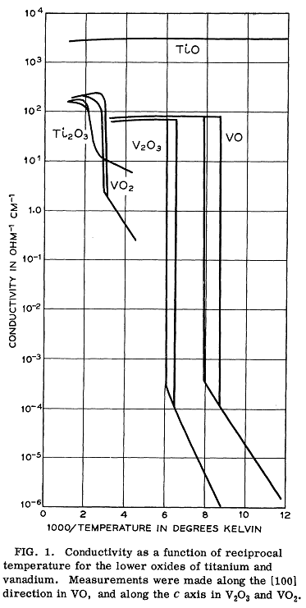
VO₂
Metal-Insulator transition at 340 K,
also structural change:low T monoclinic,
high T tetragonal (rutile) !!
Band insulator?
Mott Hubbard insulator?
Valence electrons V: 3d³4s²
So V⁴⁺ : 3d¹

Slide 3
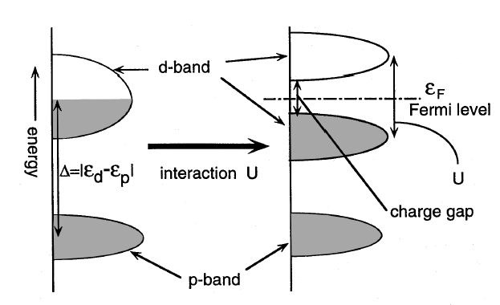

Slide 4
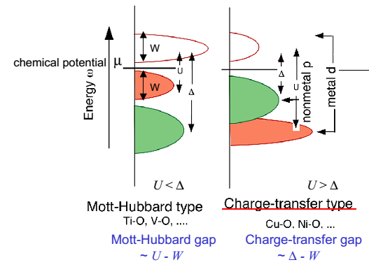
Mott vs Charge transfer

Slide 5
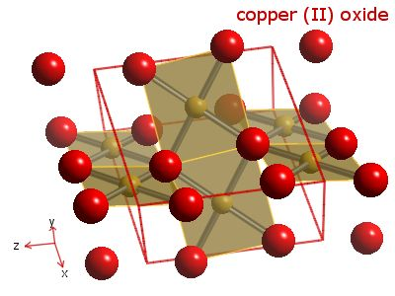
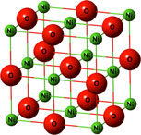
CuO & NiO
CuO
NiO
Cu²⁺: [Ar] 3d⁹
Ni²⁺: [Ar] 3d⁸
Notes:
CuO Mott insul.
NiO Charge transfer insul
CuO monoclinic, NiO rocksalt

Slide 6
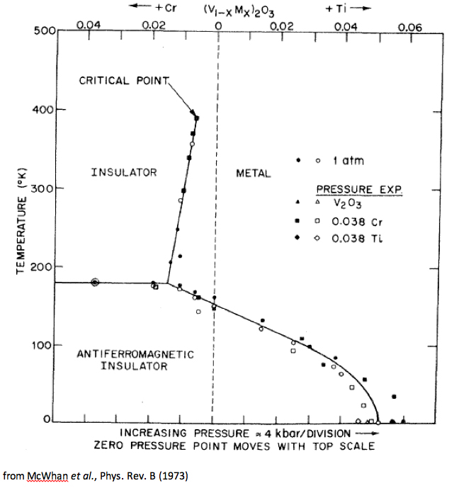
t/U ↓
t/U ↑
U↑
U↓

Slide 7
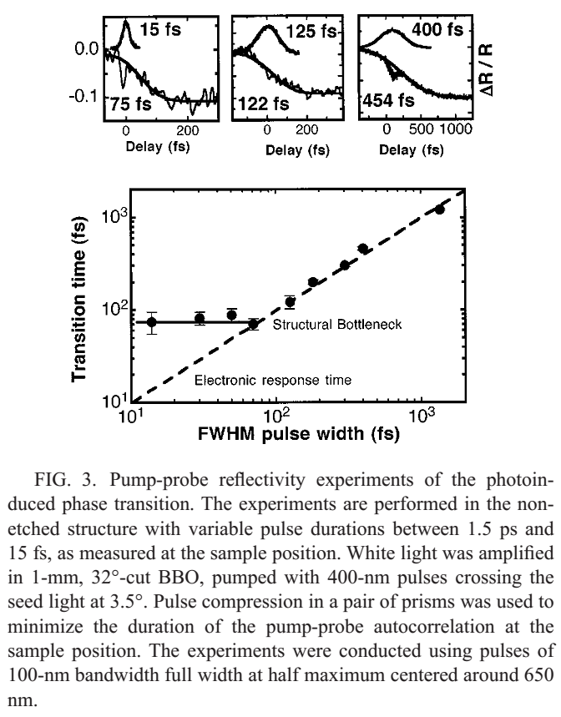
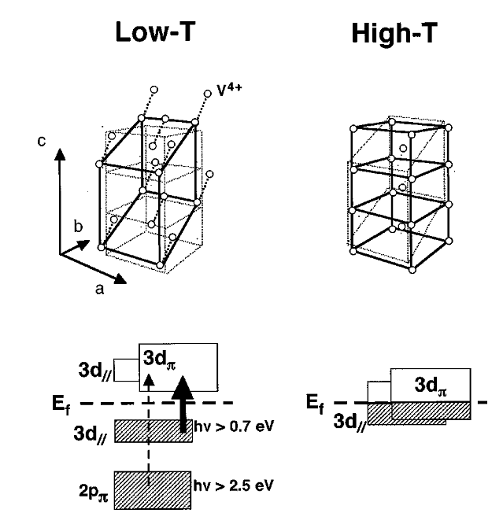
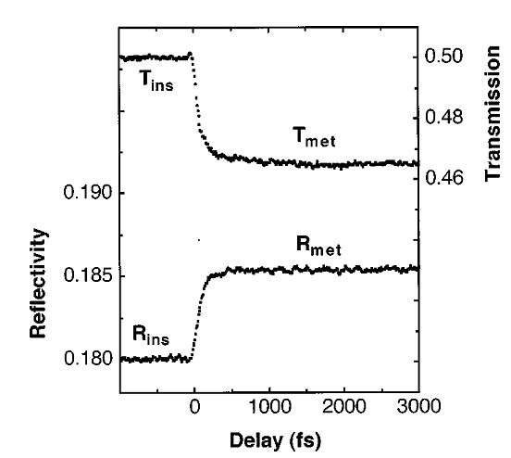

Slide 8
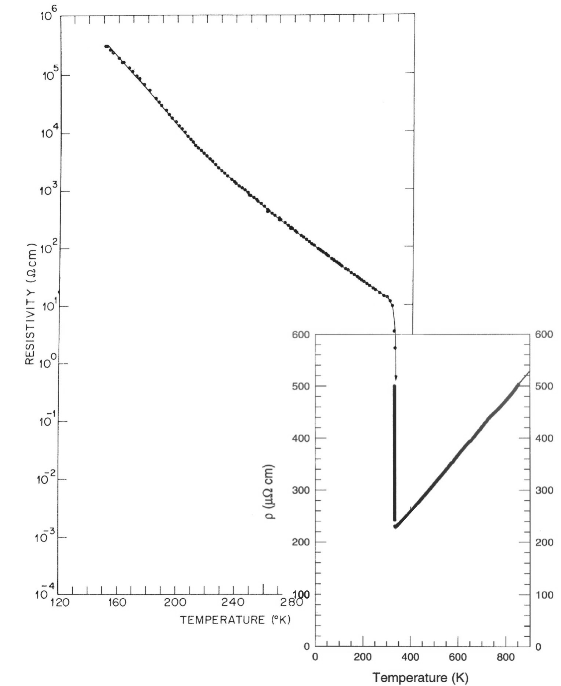
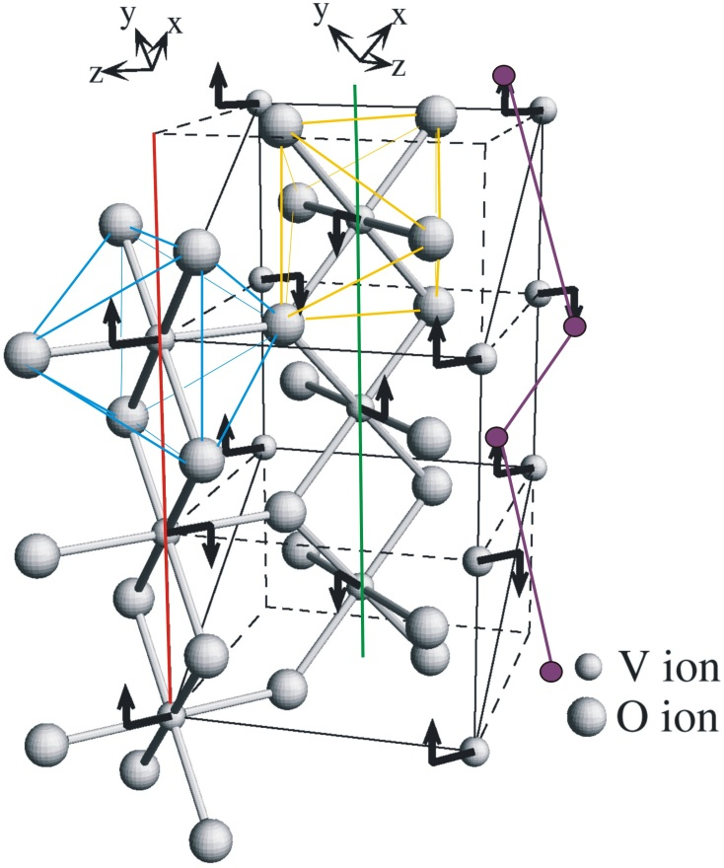
Metal insulator transition in VO₂ at 340 K
T > 340K: metal, rutile
T < 340K: insulator, monoclinic,
dimerized zig-zag chain
M. Marezio et. al.,
Phys. Rev. B 5, 2541 (1972)
log-scale
linear scale
P. B. Allen et. al.,
Phys. Rev. B 48,
4359 (1993)
Dimerization → Peierls transition = band structure effect
Combination of Peierls and Hubbard physics

Slide 9
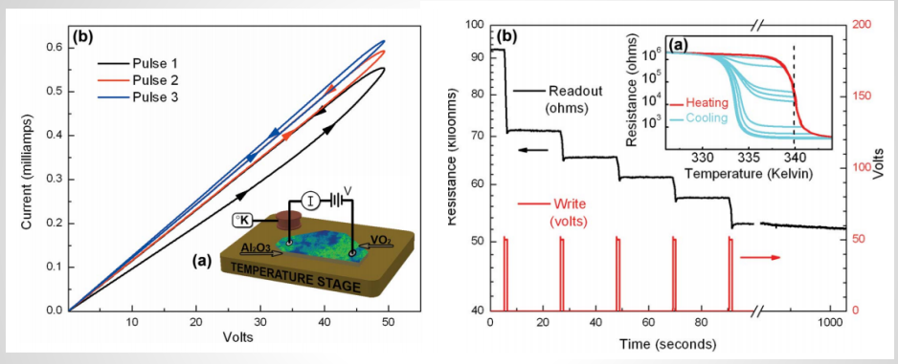
VO₂ Memristors
Driscoll, T., Applied Physics Letters 95 (2009)

Slide 10
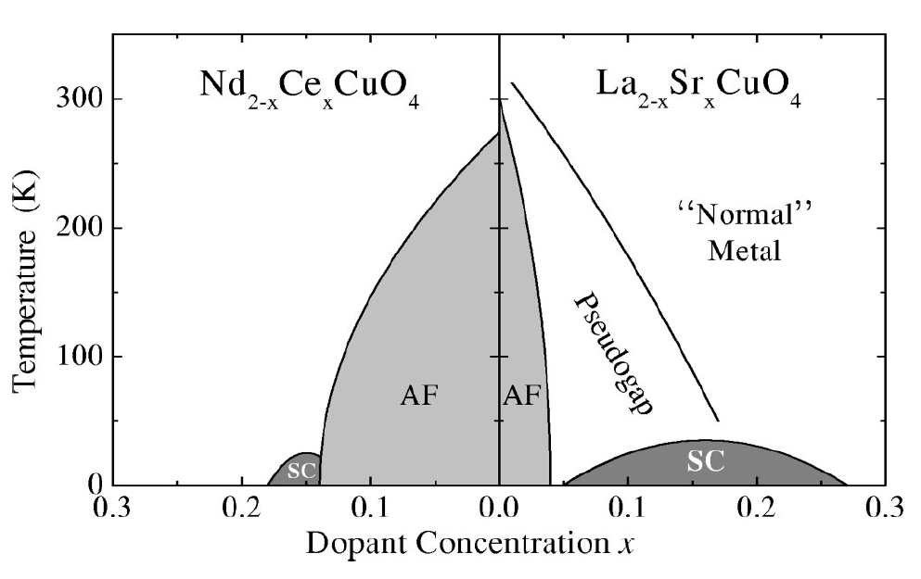
High temperature superconductivity
Adapted from Patrick Lee and T. Senthil

Slide 11
CuO plane: strongly-correlated electron system
One hole per site: should be a metal according to band theory.
Mott insulator.
t
Undoped CuO₂ plane:
Mott Insulator due to
e⁻ - e⁻ interaction
Virtual hopping induces
AF exchange J=4t²/U
CuO₂ plane with doped holes:
La³⁺ → Sr²⁺: La_{2-x}Sr_{x}CuO₄
Adapted from Patrick Lee and T. Senthil
Notes:
Here is the illustration of the electron transport in the undoped CuO plane first. (Technion: you’ve probably had a more elaborate intro to this subject from Assa Auerbach)
Doping restores the ele conductivity by creating cites at which the holes can jump without paying the cost in Coulomb repuls. The doping is achieved by chemical subitution of La by Sr or by adding additional oxygen into the lattice. As a result of doping, the holed can now move around. However, as you see, doping destroys the AFM order very quickly because this spin after the hole move there wants to be down rather than up. The most famous example of a HTC material is LSCO, which is very similar to the originally discovered LBCO.
So, the 2 basic features which characterize the HTCS materials:
(i) key structural unit shared by all the materials is CuO plane. The interplane correlations are weak, so the behavior is quasi-2D
(ii)HTSC’s are created by doping Mott Insulators
This combination creates the fundamentally different behavior as compared to the “old”, regular superconductors like merculry, Al, NbSe2, etc.
First,CuO plane is a 2D spin-half Heisenberg AFM with very large coupling J, of 1500K. The AFM is due to the superexchange interaction between Cu spins through Oxygen p-orbitals.
Second, there is one hole on every Cu cite, so the conduction band is only half filled. However, hoping between cites is prohibited because the Coulomb energy of double-occupied cite is too large. Therefore, strong el-el correlation plays an important role in this system. This is in contrast to regular Fermi-liquid metals, where el kinetic energy is dominant. Mott Insul is a material, like LaCuO, in which the conductivity vanishes at decreasing T, even though the band theory predicts it to be metallic.
(J=t^2/U)
The combination of the 2-dim and proximity to Mott Insul leads to a new physics. The SC is only one of the welth of new phenomena observed and still poorly understood in HTSC.

Slide 12
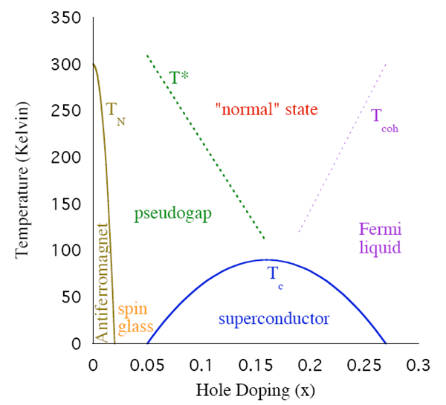
Adapted from Patrick Lee and T. Senthil

Slide 13
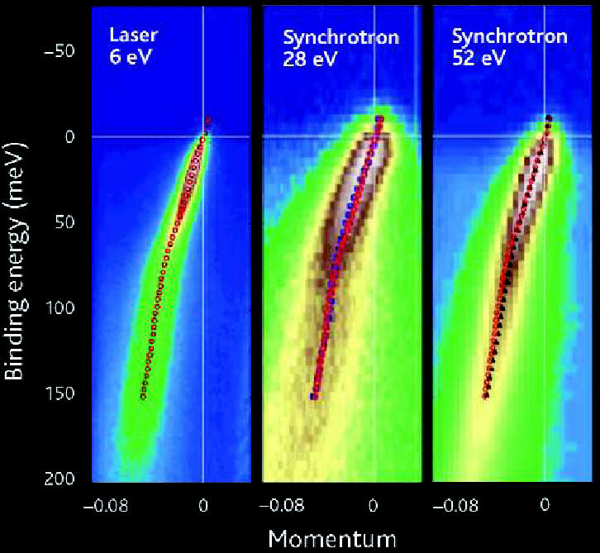
Science 310, 1271 (2005)

Slide 14
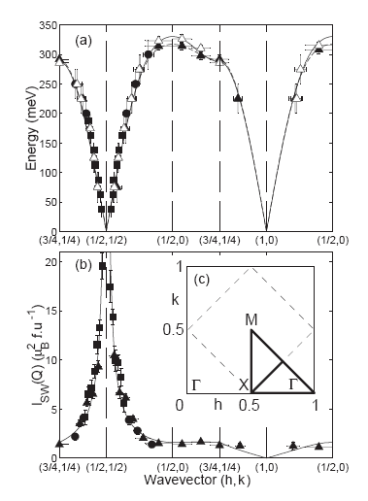
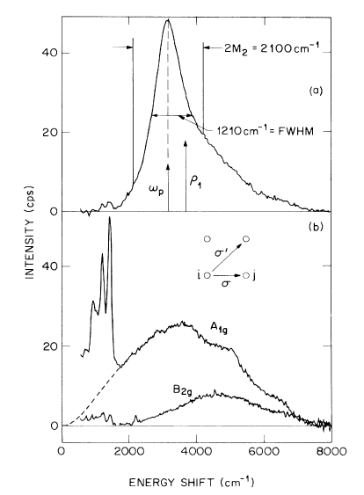
By fitting the spin wave dispersion measured by neutron scattering. (also needs a small ring exchange term.)
Also from Raman scattering.
Spin flip breaks 6 bonds, costs 3J.
Largest J known among transition metal oxide, except for the Cu-O chain compound where J=220meV.
Adapted from Patrick Lee and T. Senthil

Slide 15
